Slide 1



Session 2: Financial Innovation and Integrity
Fintech’s Role in Strengthening Governance and Accountability
2025 World Anti-Corruption Conference
Rhodes House, Oxford, United Kingdom
24 October 2025
National Anti-Financial Crime Centre (NFCC)
Prime Minister’s Department
MALAYSIA

Slide 2




Speed
Financial Innovation
Convenience
Accessibility
Fintech with Integrity!
Tool of transparency
Informal payments
Untraceable cash
Opaque system
Close the channels of corruption
Strengthen accountability

Slide 3
Improving Transparency and Reducing Corruption
Digital Footprint – auditable records
Real-time reporting – flagging anomalies instantly
Automate processes – only when conditions are met
Financial efficiency
Narrowing the space where corruption can operate
+ Inclusion is vital – bringing the unbanked into formal finance Digital Footprint – auditable records
…corruption thrives in opacity, and fintech’s greatest contribution is its ability to make financial flows visible, traceable and accountable

Slide 4


Assessing the RISK:
Fintech innovation moves faster than legislative and regulatory updates
Unlicensed or semi-regulated fintech firms operates in areas not fully covered by the Financial Services Act or Anti-Money Laundering Act (AMLA)
Issuance of comprehensive regulatory frameworks by financial sector regulators
e.g. while guidelines for e-KYC and digital banks, non-bank e- wallet providers still operate under lighter regimes, leading to potential consumer exposure and AML blind spots
Rapid expansion of services
e.g. :
Peer-to-peer (P2P) lending
Digital asset exchanges
Buy-now-pay-later (BNPL)
Mitigation:
BNM’s Regulatory Sandbox and the Financial Sector Blueprint 2022–2026 encourage innovation within controlled parameters — ensuring emerging fintech models are tested
under supervisory oversight before full licensing.

Slide 5
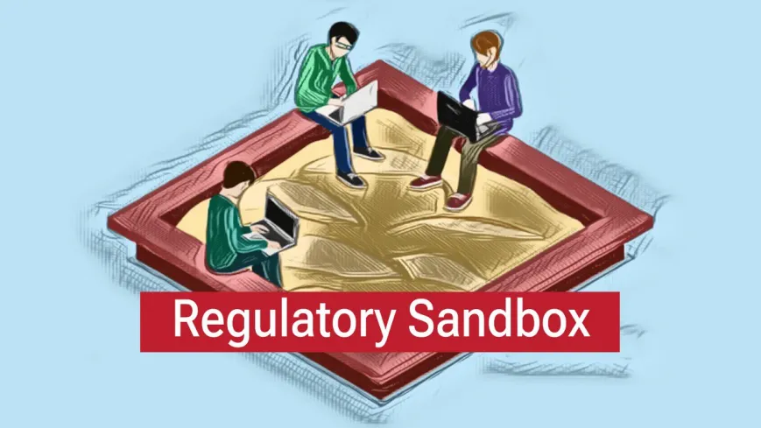
to provide a regulatory environment that is conducive for the deployment of financial technology
facilitate overall innovation in the Malaysian financial sector
As advances in financial technology have led to the introduction of new business models and solutions, the Regulatory Sandbox seeks
to encourage innovation and the delivery of financial services by granting regulatory flexibilities for fintech solutions with genuine value proposition to be experimented in a production or live environment.
Such flexibilities will be accompanied by appropriate safeguards..
to preserve financial stability,
integrity of financial transactions,
ensure fair business conduct, and
fair treatment to consumers.
The Regulatory Sandbox comprises two tracks:
Standard Sandbox, which refers to the standard procedures introduced in October 2016 to allow fintech companies to test innovative solutions; and
Green Lane, an accelerated track introduced in February 2024, that provides a simpler and quicker way for financial institutions with strong track record in risk management capabilities to test innovative solutions that face regulatory impediments.

Slide 6
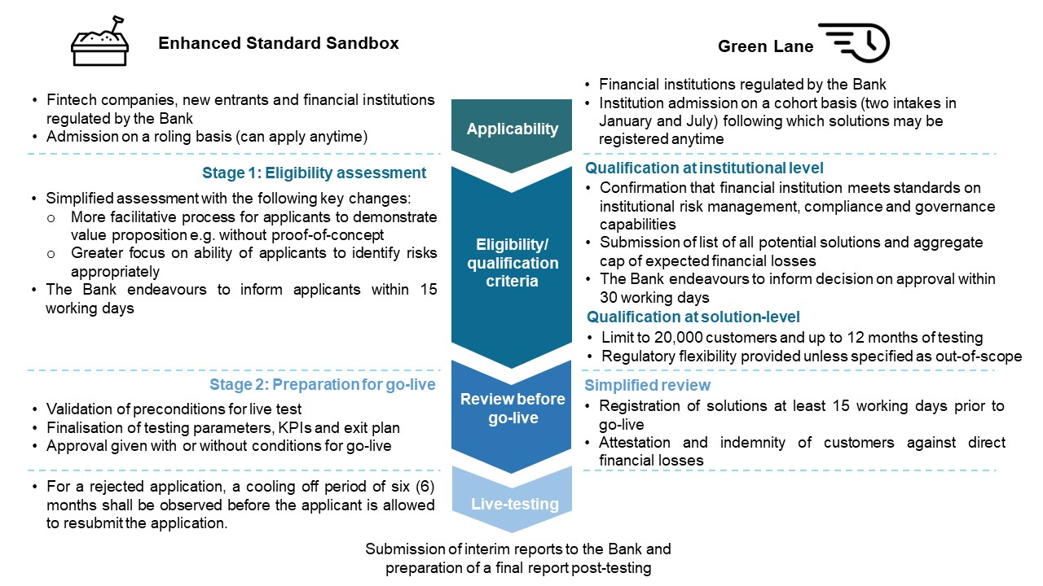
The diagram below shows a comparison between the Standard Sandbox and Green Lane.

Slide 7



Principles Behind the Sandbox
The establishment of the Sandbox Framework and broader efforts by the Bank to facilitate innovation in financial services are guided by three key principles:
Parity
level playing field for all industry players
“same risks, same rules”
regulations will need to be adjusted to address risks associated with new technologies and business models, in order to facilitate the creation of value through innovative solutions.
Proportionality
ensure that requirements appropriately reflect the complexity and risk profile associated with a particular business activity or entity
balance between achieving the desired policy objectives to safeguard public interest and minimising regulatory burden for the financial services industry.
Neutrality
designed to achieve its desired policy objective without preference or bias to specific technologies or methods
Market participants have the flexibility to choose the most appropriate technology /methods based on their needs and business model.
different technologies/methods may carry different risks, which in turn attracts different regulatory requirements and implications for its business activity.

Slide 8

Risks of Misuse and Regulatory Gaps
Speed of Fintech innovation
Fintech evolves faster than law. Regulatory arbitrage allows firms to operate in grey zones, bypassing compliance. Shadow banking services can mimic banks without licenses, exposing citizens to fraud and creating channels for corruption money to circulate unseen.
Cyber risks
Wallets and exchanges are attractive targets for hackers, while weak data protection means sensitive KYC data can leak onto black markets, fuelling identity theft.
Global innovation vs local regulations
Cross-border flows can slip through jurisdictions with weaker controls, creating escape routes for corrupt funds
..robust safeguards required,
the same tools meant to increase transparency could become enablers of new corruption risks

Slide 9

Challenges for Regulators
Speed of Fintech evolution
Fintech innovation moves at the speed of code; regulation moves at the speed of parliaments
Talent gaps
Lack blockchain analyst, AI-expert, or cyber specialists needed to assess fintech risks
Jurisdictional fragmentation compounds the challenge – a fintech platform may serve millions globally, but oversight is still fragmented by national laws
Balancing act
Over-regulation may stifle innovation; under-regulation leaves loopholes wide open for abuse
..to fight corruption in the fintech era, regulators must be empowered with skills, resources, and independence

Slide 10

Supporting Anti-Money Laundering
e-KYC
verify customer identities digitally, reducing fake accounts and strengthening due diligence. Blockchain provides tamper-proof records of transactions, ensuring that financial histories cannot be erased or manipulated
Verified IDs
Mobile payments, when tied to verified IDs, make even micro-transactions visible to regulators. Imagine the difference when petty bribes, once hidden in cash, become traceable on digital platforms.
AI integration
Ability to scan millions of transactions in real time, flagging suspicious spikes, patterns, or hidden networks linked to corruption. This is not just digitization — this is the transformation of AML into a proactive shield
“The fight against money laundering begins with knowing who your customers are, where the money comes from, and where it is going — fintech strengthens all three.”

Slide 11

Emerging Markets and Public Service Delivery
Fintech reshaping governance
Direct transfers – subsidies and pensions into citizens’ mobile wallets cutting out corrupt intermediaries
Blockchain-backed procurement platforms ensure transparent bidding in public contracts, reducing favouritism and inflated deals
Digital tax collection
Expand the base and reduces evasion
Linking welfare programs to digital IDs ensures aid reaches real citizens
Even utility payments are being digitized, reducing the small-scale bribery
“Fintech not only delivering efficiency, but dismantling choke points where corruption used to flourish”

Slide 12
Closing Governance and Accountability Gaps
Theme | Key Description | Mechanism / Implementation | Impact / Benefit | Transparency & Anti-Corruption Context
Governance Transformation | Fintech reshapes not only banking but governance system | Integrates digital tools into welfare, procurement, and taxation | Increases efficiency and service accessibility | Embeds transparency and accountability in public operation
Digital Identity & Verification | Biometric and e-KYC verification for citizen services | Prevents fake beneficiaries and strengthens AML compliance | Builds reliable citizen databases | Removers “ghost accounts” used for subsidy or fund diversion
Direct Digital Transfers | Government payments sent directly to verified wallets | Replaces cash distribution with digital transfers | Faster and secure delivery of welfare and relief funds | Eliminates intermediaries and reduces leakage risks
Blockchain for Transparency | Distributed ledger for public records and procurement | Created tamper-proof, time-stamped transactions | Builds trust and integrity in public contracting | Prevents record tampering and procurement fraud
Cashless & Mobile Payment Ecosystem | QR-based and mobile wallets for everyday transactions | Converts informal cash transactions into digital trails | Expands inclusion and simplifies payments | Reduces petty bribery and enhances traceability
AI & Data Analytics | Machine learning for transaction monitoring | Detects unusual or suspicious financial patterns | Enables proactive AML actions | Uncovers hidden networks linked to corruption
Integrated Digital Ecosystem | Linking digital ID, tax, and welfare databases | Streamlines data across multiple government systems | Improves targeting and service efficiency | Prevents duplication and manipulation of records

Slide 13

Fintech is not simply about convenience
It is about integrity
design it with transparency in mind, fintech strengthens accountability, empowers regulators, protects citizens, and closes the very channels that corruption depends on
neglect regulation and safeguards, fintech will not reduce corruption — but will reinvent it
Let us ensure that fintech becomes not just a tool of finance, but a cornerstone of clean, transparent governance

Slide 14


Slide 15
1
Summary: Fintech Against Corruption — Transparency and Accountability
Theme / Area | Key Points | Impact on Transparency & Anti-Corruption
Digital Traceability vs. Cash Opacity | Digital payments generate auditable records (timestamps, receipts) traceable by regulators Prevents illicit “under-the-table” transactions | Creates permanent transaction trails, closing gaps that cash once hid
MACC’s Technology Driven Anti-Corruption Approach | MACC applies AI analytics and blockchain to detect fraud patterns and irregular financial flows Blockchain ensures immutable records – AI enables early anomaly detection | Strengthens MACC’s investigative capacity; makes financial misconduct easier to identify and prosecute
Smart Contracts and Automation | Blockchain-based smart contracts automate payments (e.g. procurement, subsidies) Transactions execute only when predefined conditions are met | Removes human discretion in approval processes, minimizing opportunities for bribery
E-Procurement for Real-Time Monitoring | Digitizes tenders and supplier payments, allowing real-time auditing MACC can monitor anomalies instantly via forensic dashboards | Enhances procurement transparency; reduces manipulation, favoritism, and kickbacks
Shift Toward a Cashless Public Sector | Government promotes e-wallets and bank transfers for welfare, salaries, and subsidies Direct transfers eliminate intermediaries and fund diversion risks. | Ensures funds reach real beneficiaries; minimizes leakage and misappropriation

Slide 16
Theme / Area | Key Points | Impact on Transparency & Anti-Corruption
Pandemic-Era Efficiency | During COVID-19, digital disbursements (e.g., Bantuan Prihatin) ensured fast, secure aid delivery Reduced misappropriation and manual bottlenecks | Demonstrated fintech’s effectiveness in ensuring transparent, rapid crisis response
National Blockchain Roadmap (2021– 2025) | Sets direction for government-wide adoption of distributed ledger technologies Strengthens transparency, trust, and data integrity in governance | Institutionalizes blockchain-based accountability and auditability
Malaysia Blockchain Infrastructure (MBI) & MyDigital ID | Developed by MIMOS Berhad as a blockchain-secured digital identity and wallet system Guarantees tamper-proof records and secure service access | Builds digital trust architecture across public services; eliminates record manipulation
Outcome & Governance Impact | Integration of blockchain, e-wallets, and AI enhances transparency, efficiency, and public trust Closes corruption loopholes and modernizes governance processes | Establishes a digital anti-corruption ecosystem across Malaysia’s public sector

Slide 17
2
Summary: Risks of Misuse and Regulatory Gaps in Fintech
Risk Area | Description | Key Issues / Causes | Malaysia Example | Mitigation / Response | Transparency & Corruption Context
Fintech Outpacing Regulation | Innovation evolves faster than legislative updates | Regulatory gaps and inconsistent AML enforcement (regulatory arbitrage) | Fintech startups operate beyond existing FSA/AMLA frameworks | Develop agile, risk-based regulations and continuous oversight updates | Loopholes exploited by illicit actors to move unmonitored funds
Shadow Banking Concerns | Unlicensed lending apps mimic banks without safeguards | No licensing or capital requirements; weak consumer protection | “Instant loan apps” led to misuse and illegal collections | Consumer Credit Act (2025) introduced; CCOB (BNM&MOF) to oversee non-bank lenders | Enables hidden loan channels for laundering and fraud
Cyber & Fraud Threats | e-Wallets, P2P and crypto exchanges are hacker targets | Weak cybersecurity practices and patchy incident response | Increasing cyber incidents in fintech platforms | Enforce ISO/EIC 27001 standards, mandatory audits, and AI-driven fraud detection | Cyber fraud erodes user trust and weakens AML traceability
Data Privacy & KYC Exposure | Centralised biometric/e-KYC databases vulnerable to leaks | Poor encryption and over-centralised data management | Data breaches in e-KYC platforms (2023-2024) | Use blockchain secured identity (MyDigital ID); decentralised sensitive data | Stolen identities used for fake accounts or shell operations

Slide 18
Summary: Risks of Misuse and Regulatory Gaps in Fintech
Risk Area | Description | Key Issues / Causes | Malaysia Example | Mitigation / Response | Transparency & Corruption Context
Cross-Border Laundering Risks | Fintech operates globally, regulation is national | Funds move via jurisdictions with weak AML frameworks | ASEAN DuitNow QR interoperability increases AML/CFT exposure | BNM strengthens ASEAN Payment Connectivity & Egmont Group STR exchange | Criminals exploit weak jurisdictions for illicit cross-border transfers
Insider Corruption & Governance Loopholes | Internal staff manipulate systems for gain | Weak internal controls, poor segregation of duties | Procurement-linked data tampering cases investigated by MACC | Apply segregation of duties, real-time dashboards, and integrity vetting | Insider collusion hides illicit flows and erodes institutional trust
Over-Concentration Risks | Market dominated by few fintech giants (PayNet, TNG, GrabPay) | Systemic vulnerability and monopolistic behaviour | Heavy reliance on limited providers increases risk exposure | Introduce open-banking standards and multi-provider models | Market dominance can enable collusion or policy capture

Slide 19
3
Summary: Supporting Anti-Money Laundering
Answer | Desription | Reasoning | Benefits | Transparency & Corruption Context
e-KYC | Digital ID + biometrics to verify customers | Prevents fake accounts and strengthens customer due diligence | Builds clean databases for regulators | Makes it harder to create “ghost accounts” for laundering bribes etc
Blockchain | Distributed, tamper-proof ledgers | Transactions are time-stamped and public (in permissioned settings) | Simplifies forensic audits | Bribe-related transactions become traceable in the chain
Mobile payments | Wallets tied to verified IDs | Cash replaced with traceable mobile flows | Even small corruption-related payments are logged | Petty bribery (e.g. traffic police bribes) harder to sustain digitally
AI integration | Machine learning detects patterns across millions of transactions | Identifies structuring, layering, or unusual flows | Faster red-flagging reduces laundering | Detects corruption linked financial networks before finds exit the system
Network analytics | Transaction graphs reveal hidden ties | Can show links between multiple accounts and shell entities | Helps investigators connect dots | Corruption cartels are revealed through their financial footprints

Slide 20
4
EXAMPLES OF FINTECH APPLICATIONS IN MALAYSIAN PUBLIC-SECTOR INITIATIVES
Initiative | Fintech Tools | Purpose | Impact / Outcome
E-Tunai Rakyat (2020) – Federal Government & e-wallet providers (Touch’n Go, Boost, Grab) | Mobile digital wallets (with e-KYC verification) and QR payments | Stimulate cashless usage among citizens Encourage adoption of e-wallets for daily transactions (anti-cash, pro-transparency) | 6 million citizens claimed RM30 credit in first month (RM180 million disbursed) Boosted e-wallet sign ups and prompted >16,000 new merchants to join digital payment platforms
National QR Standard – DuitNow QR (2019) – Led by BNM / PayNet | Interoperable QR code system linking 50+ banks and e-money apps | Enable universal cashless payments (P2P, retail, government) with one QR code Increase transparency as all transactions go through regulated channels | Adopted by 2.6 million merchants nationwide by 2024 (from hawkers to government offices) E-payments per capita more than doubled (111 in 2017 to 285 in 2023) Provides auditable, real-time transaction data to banks and regulators
BNM e-KYC Framework (2020) – Implemented by banks and fintech firms | Biometric ID verification (face recognition, MyKad OCR) and AI-based document checks | Allow remote digital onboarding of customers for banks, e-wallets, and event government services Expand financial access and prevent identity fraud (AML/CFT compliance | Enabled rapid growth of digital accounts: major e-wallets hit tens of millions users as onboarding time dropped to minutes (e.g. TNG eWallet >20 million verified users by 2024) Improved inclusion (esp. during COVID) while maintaining accountability in customer identification
MyDigital ID & Blockchain Infrastructure (2023) – MIMOS and JPN (NRD) | Blockchain-based national digital ID platform (with built-in digital wallet and biometric login) | Provide a secure, unified digital identity for Malaysians to access multiple services (government and private) with trust and privacy Ensure immutable records of identity data and transactions | In progress: Launched as a “super app” integrating MyKad details, aiming to onboard agencies and banks Expected to streamline cross-agency identity verification and reduce duplication of records Enhances data integrity and user convenience in public service delivery

