Slide 1


How Digitalization has Progressed in Anti-corruption Efforts in Korea
October 24, 2025
Jungoh Son, ACRC Korea

Slide 2
Rationale: Why Digitalization matters for anti-corruption
< Klitgaard Formula >
C
M
D
A
=
+
-
(Corruption)
(Monopoly
Power)
(Discretion)
(Accountability)
Decrease monopoly power (M) of governments by facilitating civic participation.
Reduce officials’ discretion (D) via contact-free and streamlined transactions.
Enhance accountability (A), integrity and transparency.

Slide 3
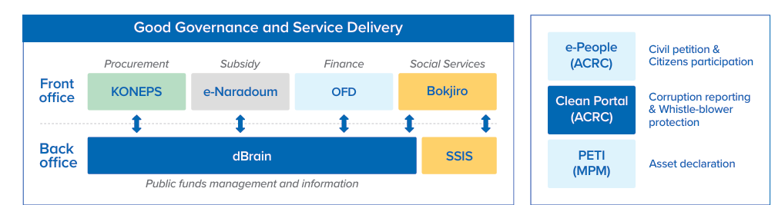
Korea’s E-government Ecosystem
In Korea, key areas of good governance and service delivery are covered by various E-Systems in both the front and back office.
There are also E-Systems directly engaged in anti-corruption and integrity, particularly in monitoring and oversight.

Slide 4
Challenges and Mitigation Measures for Digitalization
Challenges | Mitigation Measures
Insufficient funding for the development and maintenance of the digital platform Resistance from public institutions regarding closely monitored digital system Lack of legal and institutional frameworks Inadequate training and policy support for staff and relevant personnel Inadequate promotion and public awareness of the system | Justify government investment in the digital anti-corruption platform / E-government platform Establish legal and institutional frameworks Promote user engagement and public awareness Monitoring and evaluation of the anti-corruption E-government platform

Slide 5
Lessons Learned for Anti-Corruption Agencies
A whole-of-government approach and sustainable investments are crucial for the adoption and development of digital platforms.
Clear guidelines and regulations must be in place to support the system.
A monitoring and evaluation mechanism should be implemented to ensure transparent government spending and the continuous improvement of the system.
Global knowledge exchanges and learning processes are crucial for the development of digital platforms.

Slide 6
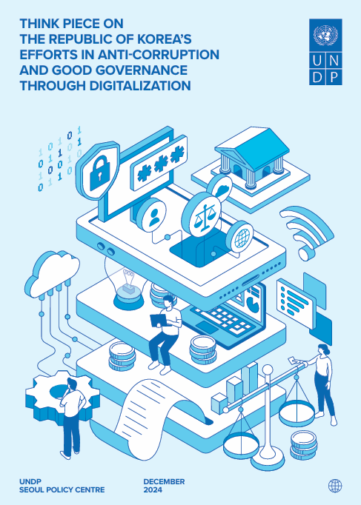
Thank you so much.
Please, find this useful publication at the UNDP Seoul Policy Centre.

