Slide 1


How financial services can reduce corruption
Aml index 2025-2026
DR. JANET BASTIMAN
Chief data scientist
Notes:
Hello and welcome.
My name is Dr. Janet Bastiman, Chief Data Scientist at Napier AI. This is the second annual iteration of the Napier AI / AML Index.

Slide 2
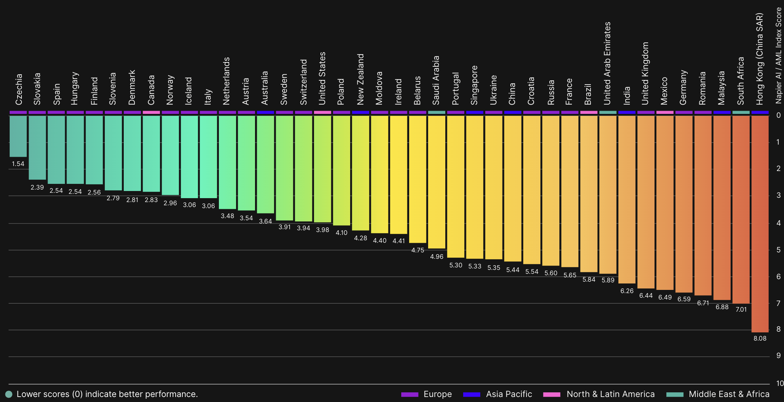
Napier ai / aml index
Ai index 2025-2026
Notes:
Historically, there has been very limited information available that quantifies the spend on financial crime compliance and its ultimate effectiveness. The Napier AI / AML Index was the first to provide a global outlook on this correlation.
The Index is designed to pinpoint what good looks like in the careful balance between efficiency and effectiveness in Anti Money Laundering. The Index, like Napier AI itself, is designed by data scientists (including me) and built on data science. It is designed to illustrate the art of the possible for AML and AI, by highlighting national regimes and financial services markets that are achieving great AML outcomes through innovations in AI.

Slide 3
HEADLINE NUMBERS
Nextgen aml
$5.5 tn GLOBAL LOSSES
$183 bn TCO SAVINGS
$3.3 tn ECONOMIC RECOVERY
+2% MONEY LAUNDERING GROWTH
+5% INCREASED COST OF COMPLIANCE
©2025 NAPIER TECHNOLOGIES LIMITED | PRIVATE & CONFIDENTIAL
Notes:
It is well documented that the equivalent of 5% of global GDP is estimated to be laundered every year. What’s interesting about that is the rising value of those losses (up $300 billion from last year), the rising cost of compliance, and the increasingly tangible benefits of AI for AML.
The Index found that regulated firms like banks, payments firms, wealth & asset managers, telcos and insurance companies can save $183 billion (up from $138 billion last year) on compliance costs by implementing AI into their AML strategies.
And that $3.3 trillion could be returned to global economies with AI-powered AML strategies (up from $3.13 trillion last year).
AI for AML is no longer nascent, with multiple national initiatives focused on encouraging and facilitating compliance-first AI innovations. Because of this, the potential benefit of AI for AML in terms of TCO savings and recouping economic value are rising. Also rising is the rate of financial crime and associated losses, creating a catalyst for AI in AML that delivers both efficiency and effectiveness for nations and financial institutions.

Slide 4
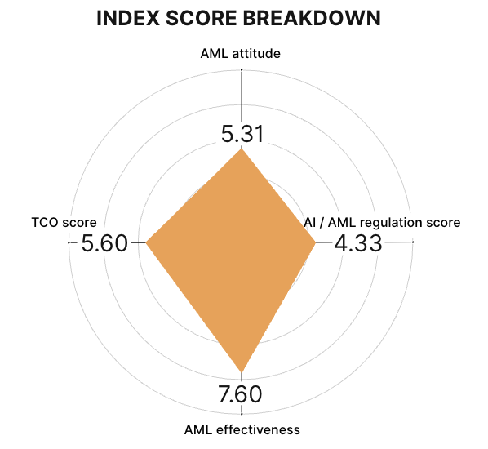
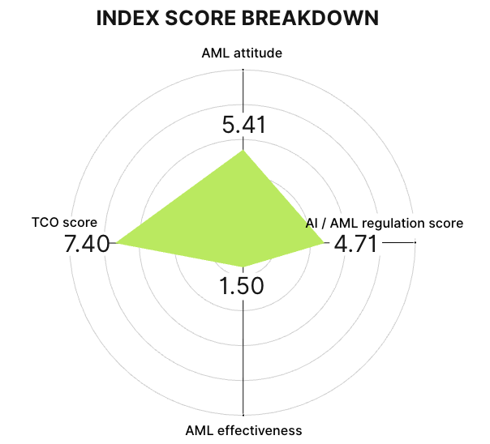
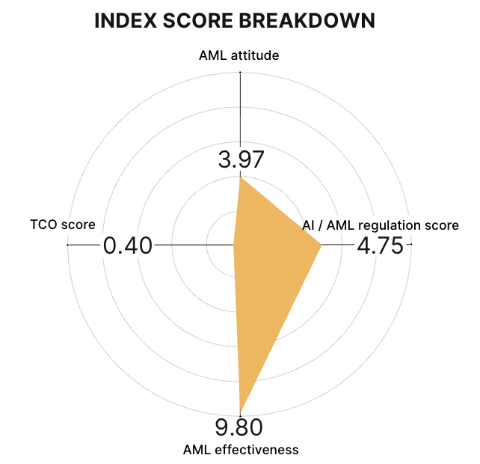
Aml index 2025-2026
COUNTRIES FEATURED
UK
USA
UAE
Notes:
Some markets and their respondents show indications that they are experiencing challenges in holding back the tide of financial crime.
The biggest 'losers’ in terms of AML attitude were UK and USA, who ranked much better last year, perhaps indicating fatigue from increasing financial crime and alert volume and sanctions inflation, without a clear end in sight.
Australia remains near the bottom of the AML attitude rankings for the second year in a row, and also continues to score poorly for AI/AML Regulation, perhaps indicating the negative sentiment of the market regarding the ongoing AML reforms creating significant challenges for FIs, but ultimately demanding excellence in AML from its market participants. The real-terms improvement in its AI/AML Regulation score could also indicate that while AML reforms have caused some pain, ultimately the market believes that they are directionally correct, and see the potential for AI to remove some of the operational burden.
For every market evaluated within the Index, there’s an interesting story to uncover amongst the four category scores, even for those that rank lowest in certain categories (such as AML Attitude). These indicate the reasons for challenges in AML in the region, as well as providing some forecast for when the tide might turn in favour of the financial institutions fighting the good fight.

Slide 5
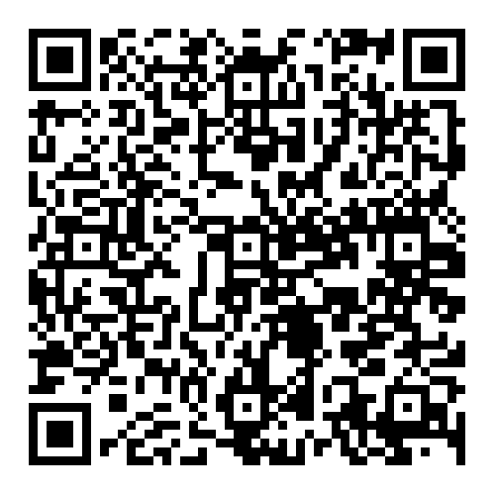
READ THE INDEX
Notes:
Check out the other videos in this series to dive into the four global trends we uncovered in the data.

