Slide 1


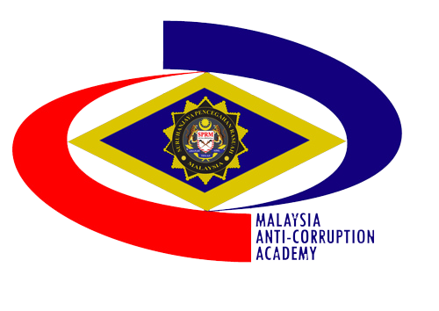


ADVANCING INTEGRITY GOVERNANCE IN MALAYSIA
FROM PUBLIC SECTOR TO CORPORATE ECOSYSTEM
HAIRUZZAKI BIN MOHD YUSOF (PhD)
HEAD OF PLANNING, RESEARCH AND CORPORATE
MALAYSIA ANTI-CORRUPTION ACADEMY (MACA)

Slide 2


CONTENT
01
Integrity Governance Evolution
02
Public to Private Expansion
03
Challenges and Future Direction

Slide 3


01
Integrity Governance Evolution

Slide 4


Foundation of Good Governance
01
National Anti-Corruption Plan 2019-2023
01
Strategic framework establishing integrity as cornerstone of Malaysian governance agenda.
Integrity Units
03
02
Implemented across public sector to institutionalize accountability and transparency practices.
03
02
National Anti-Corruption Strategy 2024-2028
04
Policy Integration
04
Is a continuation of the National Anti-Corruption Plan (NACP), as a comprehensive plan to integrate efforts in addressing issues related to governance, integrity, and anti-corruption.
Aligning integrity initiatives with broader national development and administrative reform objectives.
Notes:
Notes: NACP outlines long-term visions on the anti-corruption actions towards a corruption-free country through 115 initiatives that are to be put into practice. Through its six strategies, NACP will ensure that the effort to combat corruption is streamlined among political actors, corporate entities, enforcement agencies and the stakeholders
The NACS emphasises five (5) strategies that bolsters 60 sub strategies. Its implementation will be driven by 19 agencies. The five overarching strategies of the NACS are:
Education
Public Accountability
Voice
Enforcement
Incentives

Slide 5







Public Sector Achievements
Established Integrity Units
Strategic Collaborations
Implemented across all ministries and agencies to strengthen governance and accountability.
MACC’s partnership with Department (JPA) and all ministries to align policies and enhance integrity initiatives.
01
02
03
04
Compliance Focus Areas
Measurable Outcomes
Developed frameworks for governance, risk management, and anti-corruption through CeIO roles.
Reduced misconduct incidents and cultivated stronger governance culture throughout public institutions.

Slide 6


Beyond Compliance to Culture
Compliance-driven to culture-based
Leadership commitment
01
02
Shifting from rule enforcement to embedded values that guide everyday decisions across all sectors.
Top management must demonstrate integrity through actions, not just policies or statements.
Continuous education
Cross-sector collaboration
03
04
Regular training programs build awareness and reinforce ethical practices throughout organizations.
Public, private and civil society partnerships create comprehensive integrity ecosystems beyond individual institutions. Such as Transparency International etc.
Notes:
Notes: Through Public Education Division and MACA of MACC.
Such as Transparency International etc.

Slide 7
02
Public to Private Expansion

Slide 8

Integrity Units Establishment
Public Sector Implementation
Collaborative Oversight
Established in all ministries and agencies with focus on 6 TORS : complaint management, integrity enhancement compliance, governance, detection and verification and misconduct management.
MACC’s partnership with Public Service Department (JPA) National Audit Department, Companies Commission of Malaysia and all ministries to ensures policy alignment and comprehensive governance standards.
GLC and GLIC Expansion
Measurable Outcomes
Model of Integrity and Governance Unit (IGU) replicated in government-linked companies with 4 TORS with corporate integrity frameworks and whistleblowing mechanisms.
Reduced internal misconduct and improved governance culture demonstrate effectiveness of integrity and anti-corruption initiatives.
245 IGU’s was established in GLC’s and private sectors
479 Integrity Unit’s was established in public sector

Slide 9
GLCs and GLICs Implementation
415 CeIO’s from private sectors
01
Integrity Unit Model Replication
01
Successful public sector framework adapted for GLCs and GLICs including public listed companies such as Petronas, Khazanah, and Sime Darby.
Corporate Frameworks based on
02
02
Development of integrity and anti-corruption frameworks with whistleblowing mechanisms tailored to corporate governance needs.
03
03
MACA Partnership (CeIO)
04
Enhanced Accountability
04
Collaboration for customized and ad-hoc training, accreditation programs, and advisory services supporting integrity implementation.
Strengthened board oversight and transparency in all government related process including procurement processes across government-linked organizations.
521 CeIO’s from 165 GLC’s

Slide 10
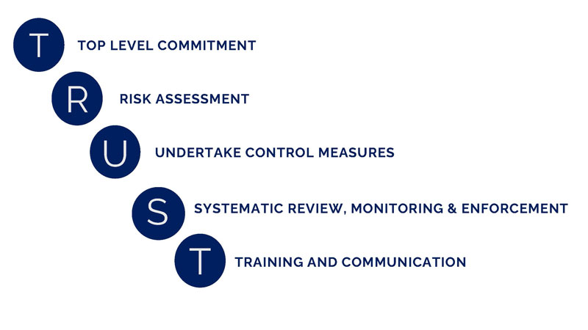
LEGAL FRAMEWORK: CORPORATE LIABILITY
01
MACC Act 2009 (17A) 2018
Section 17A of the MACC Act 2009 is a provision that stipulate corporate liability principles where commercial organization is committing an offence if any employee and/or it associated party commits bribery on behalf of the said organization
04
Principle of T.R.U.S.T
A minister guidelines to help commercial organization as one of the defence.
02
02
Corporate Liability
Development Section 17A (1) MACC Act 2009
stated as follows:
(1) A commercial organization commits an offence if a person
associated with the commercial organization corruptly gives, agrees to give, promises or offers to any person any gratification whether for the benefit of that person or another
person with the intent to obtain or retain business.
03
04
Adequate Procedures
03
Adequate Procedures is the one of
the defense mechanism in the event
a commercial organization is
charged under Section 17A MACC
Act (Amendment) 2018.

Slide 11




Private Sector Engagement
Integrity Through Supply Chains
Corporate Integrity Pledge
Industry Collaboration
Trust-Based Environment
Extending integrity practices to vendors, contractors, and clients through collaborative frameworks.
Promoting CIP and MS ISO 37001: ABMS (anti-bribery management systems) to establish ethical business standards.
Partnering with associations and chambers to build trust-based business environments.
Creating ethical business culture that extends beyond compliance to foster genuine integrity values.

Slide 12
03
Challenges and Future Direction

Slide 13
Sustaining Beyond Audits
Leadership Commitment
Continuous Education
01
02
Tone-at-the-top essential for integrity culture beyond compliance requirements.
Regular training reinforces ethical practices and prevents compliance fatigue.
MACA's Strategic Role
Cultural Transformation
03
04
Facilitates knowledge sharing and international collaboration for sustainable integrity frameworks.
Shifting from checkbox compliance to values-based ethical decision making.

Slide 14






MACA's Strategic Role
Knowledge Hub
International Collaboration
MACA provides specialized training, certification and accreditation for integrity officers across sectors.
Facilitates knowledge exchange with global anti-corruption agencies and international best practices.
Strategic Training
Advisory Services
Develops customized and ad hoc integrity programs addressing specific organizational challenges and governance needs.
Offers technical guidance on implementing integrity frameworks and anti-corruption management systems.

Slide 15
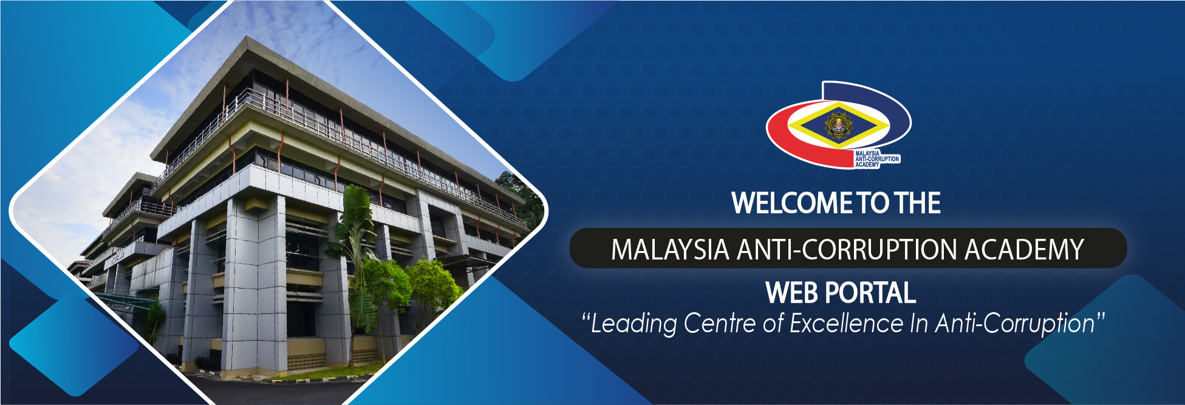
Thank You!
Email: hairuzzaki@sprm.gov.my
Web:
https://gmaca.sprm.gov.my/

