Slide 1
“Clean Portal”
Korea’s Digital Corruption Reporting System
Oct 2024
Ms. Moon Sohee
Deputy Director for General Anti-corruption Policy Division

Slide 2
- CONTENTS -
Objectives
Manage increasing numbers of reporting
Streamline the reporting process
Minimize administrative inefficiency
2. Characteristics
Reporter’s perspective
Public organizations’ perspective
ACRC’s perspective
3. Lessons learned
System developers
Development result
User-friendly service

Slide 3
1. Objectives (manage increasing numbers of reporting)
PUBLIC SECTOR
ACRC
ACT
Code
of
Conduct
Whistleblower Protection
ACT
2001
2005
2011
2016
2020
2022
Improper Solicitation and Graft Act
Government Subsidy Frauds ACT
Prevention of Conflict
of Interest ACT

Slide 4
1. Objectives (streamline reporting process)
ACRC
Investigative agencies
Reporter
Report of corrupt act
Receipt of report
Confirmation of details
Referral
(Accusation)
Investigation
Notice of investigation result
Confirm the details within 60 days after receiving a report (may extend the period by up to 30 days)
Request investigation to an investigative agency
Bring a charge against high-ranking officials to the prosecutors
Investigation by Board of Audit, investigative agencies , supervisory agencies
Complete the investigation within 60 days
Notify ACRC of result (within 10 days)
Within
30 days
Investigative
agency
Request of
re-investigation
ACRC
Notice of result
File an
objection
within 7
days
Reporter

Slide 5
1. Objectives (minimize administrative inefficiency)
Public organizations
Reporter
Investigative agencies
Reporter
Local governments
Reporter
Reporter
Administrative inefficiency caused by multiple reports to several reporting agencies
Supervisory agencies
Reporter
Reporter

Slide 6
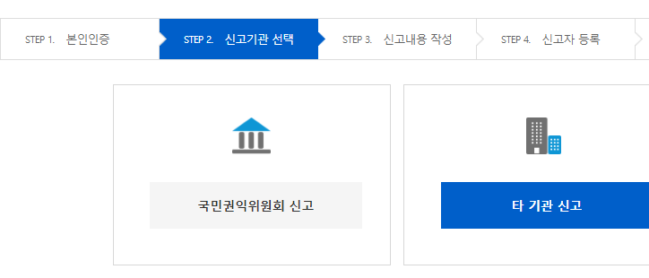
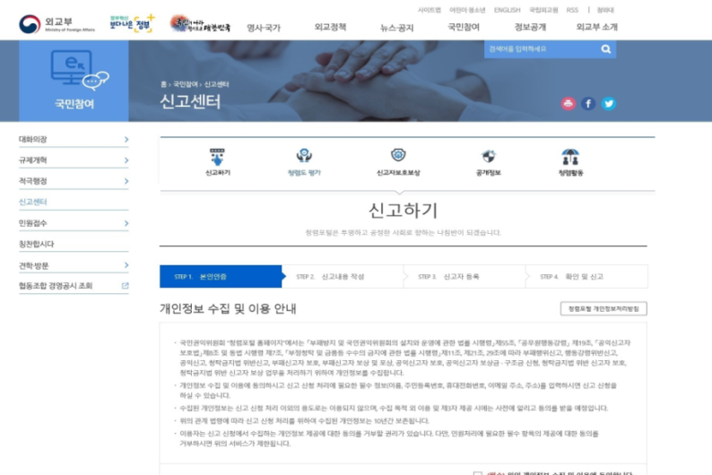
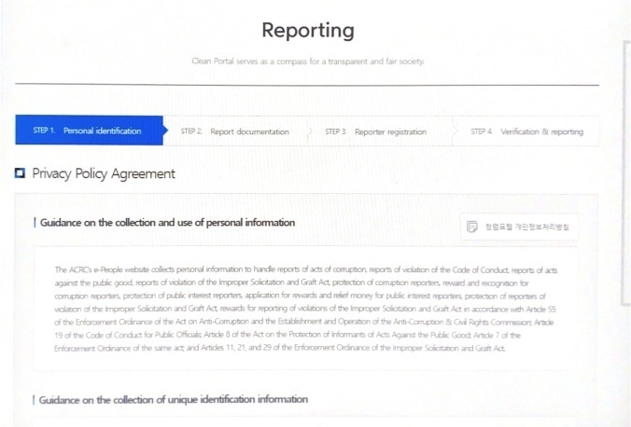
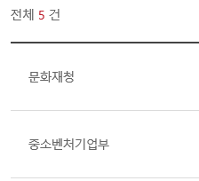
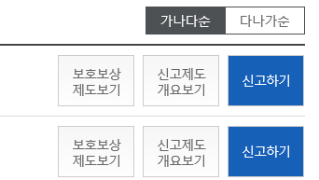
2. Characteristics (reporter’s perspective)
Enhanced Accessibility
Report to ACRC
Report to other organizations
Report not only to ACRC
but also to other organizations(970)(‘23.8.)
ABC
Cultural Heritage
Administration
Protection
& Reward
System
Report
System
Overview
Report
< EX: website of Ministry of Foreign Affairs >
Ministry of
SMEs and Startups
Protection
& Reward
System
Report
System
Overview
Report
Connected service is provided
on other organizations’ websites
to be connected to Clean Portal for reporting
Check other organizations’ report systems
and rewards systems

Slide 7
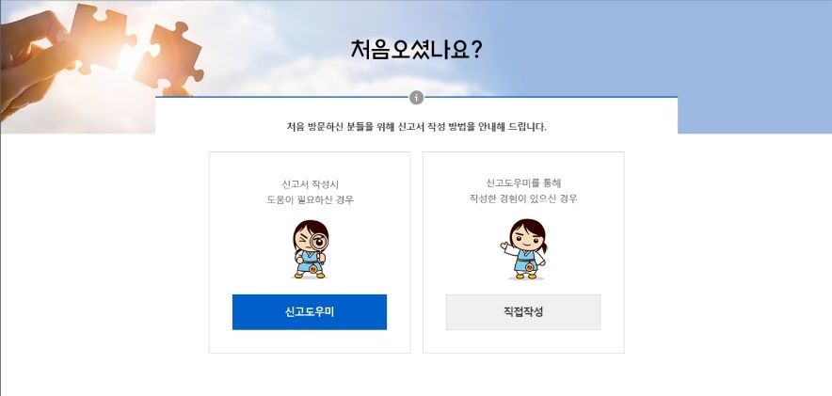
2. Characteristics (reporter’s perspective)
Improved Convenience
If you feel difficult to fill out your report form,
As long as you write down the facts accurately, ACRC will do other things for you.
Guide for Tailored Documentation
– Analyzes report data and standardizes them by report type
- Has a search function to see similar report cases, by work area, characteristic, and keyword
I intuitively know that this is a wrongdoing, but I don’t know which law it violates, nor how to fill out the form.
If you are not sure what kind of report you should make,
Is this your first visit ?
Report Documentation Guide
This is a guide to Report-filing
If you fill out the form, it will automatically analyze the contents and recommend an appropriate report type (corruption report, public interest report, etc.)
Receive help
File a report yourself

Slide 8
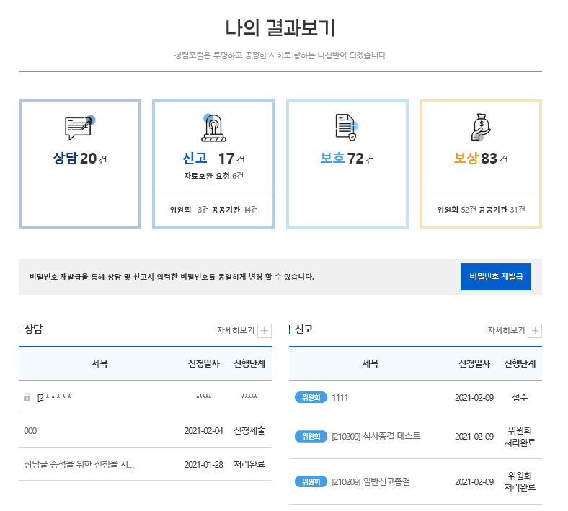
2. Characteristics (reporter’s perspective)
Real-time checking
If you wonder what’s going on…
< Check your report progress>
SMS alarm & system check
You can check your report progress at your report page.
If there is any change in the major steps (designation of investigator, input of handling result, etc.), you can be informed by SMS.
< See “My Result” >
Submit
In progress
ACRC
Completes
Processing
Referral /
Investigation
by referred
agency

Slide 9
2. Characteristics (public organizations’ perspective)
Increased work efficiency
Before
Each public organization received and handled reports separately.
Public organizations can use Clean Portal function to be connected to the works of ACRC and handle reports by themselves using Standard Report System.
After
Currently, 349 public organizations receive and handle reports on “Clean Portal” (as of Feb. 2022)
Report received
Review
Complete
Processing
Investigate referred case
Assigned to
Complete
Assigned to person in charge
Refer/ forward to relevant agency
Handled in ACRC
Investigate and take measures on referred reports based on the information the ACRC refers(forwards), and notify the ACRC of the result

Slide 10
2. Characteristics (public organizations’ perspective)
Reduced burden of cost and workforce
Reporter
Public organizations
Investigative agencies
Reporter
Digital Anti-corruption System
Local governments
Receives reports and refers them to investigative agencies, etc.
Reporter
Supervisory agencies
Reporter

Slide 11
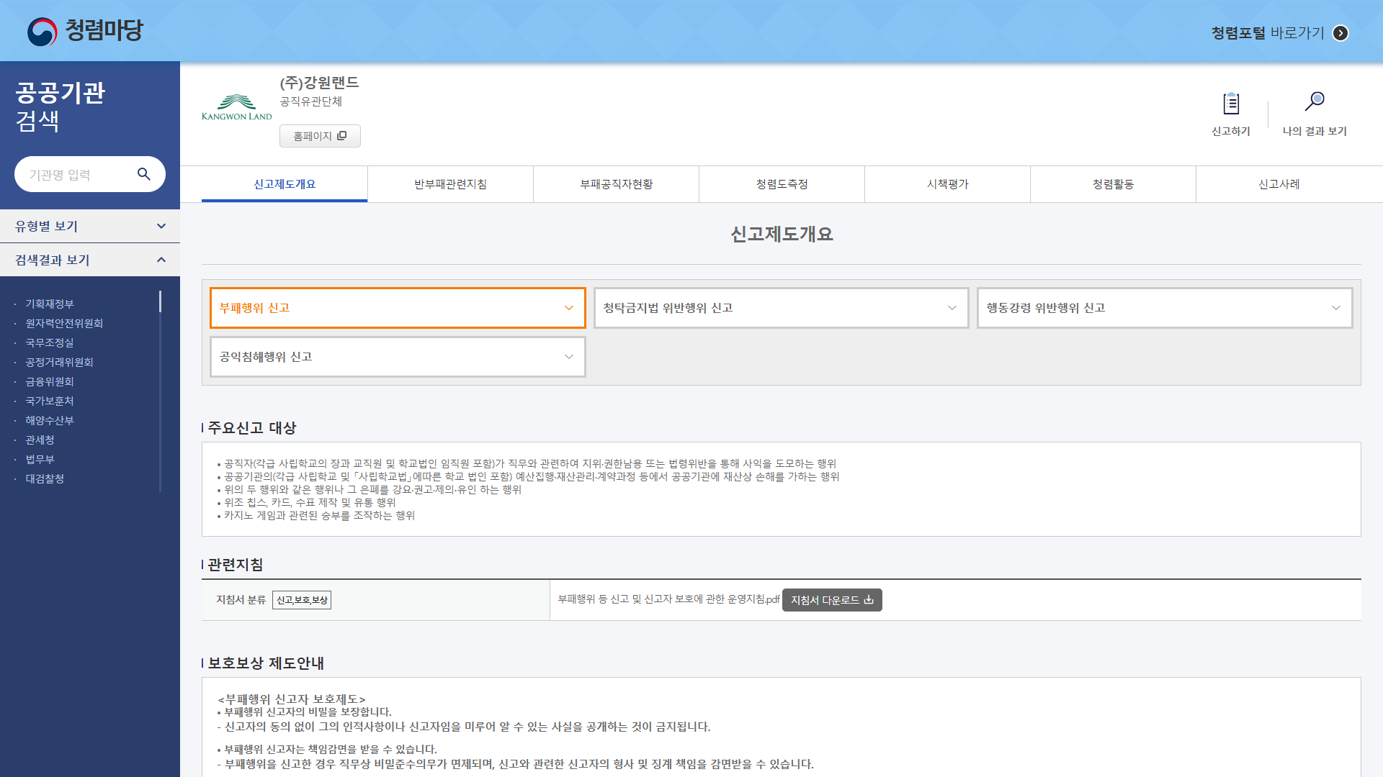
2. Characteristics (public organizations’ perspective)
Accumulated data for utilization
1,100 organizations operate “Clean Forum(comprehensive anti-corruption information system)” (‘23.8.)
Anti-corruption Guidelines
Result of Anti-corruption Initiative Assessment
Information of officials dismissed for corruption
Report examples, etc.
Information of corrupt officials
Integrity assessment
Integrity activities

Slide 12
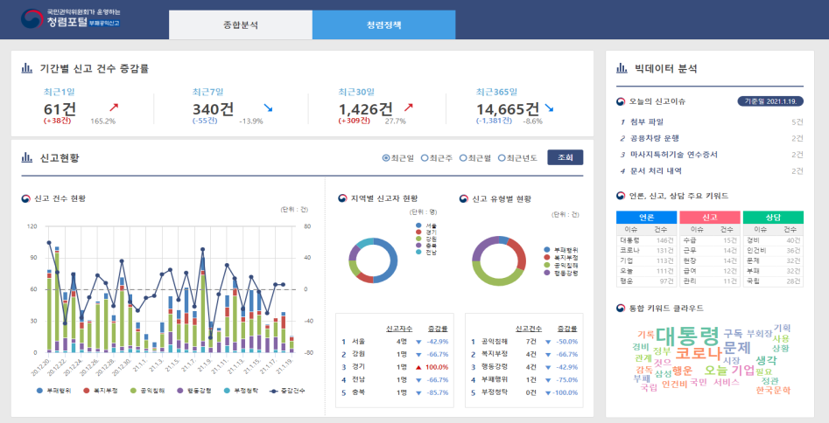
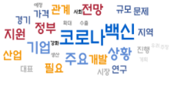
2. Characteristics (ACRC’s perspective)
Data utilization for anti-corruption policy
Comprehensive
anti-corruption plan
Guidelines for anti-corruption
& integrity policies
Institutional improvement for corruption prevention
< Real-time analysis of report data>

Slide 13
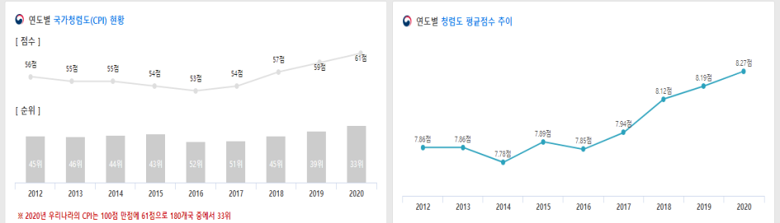
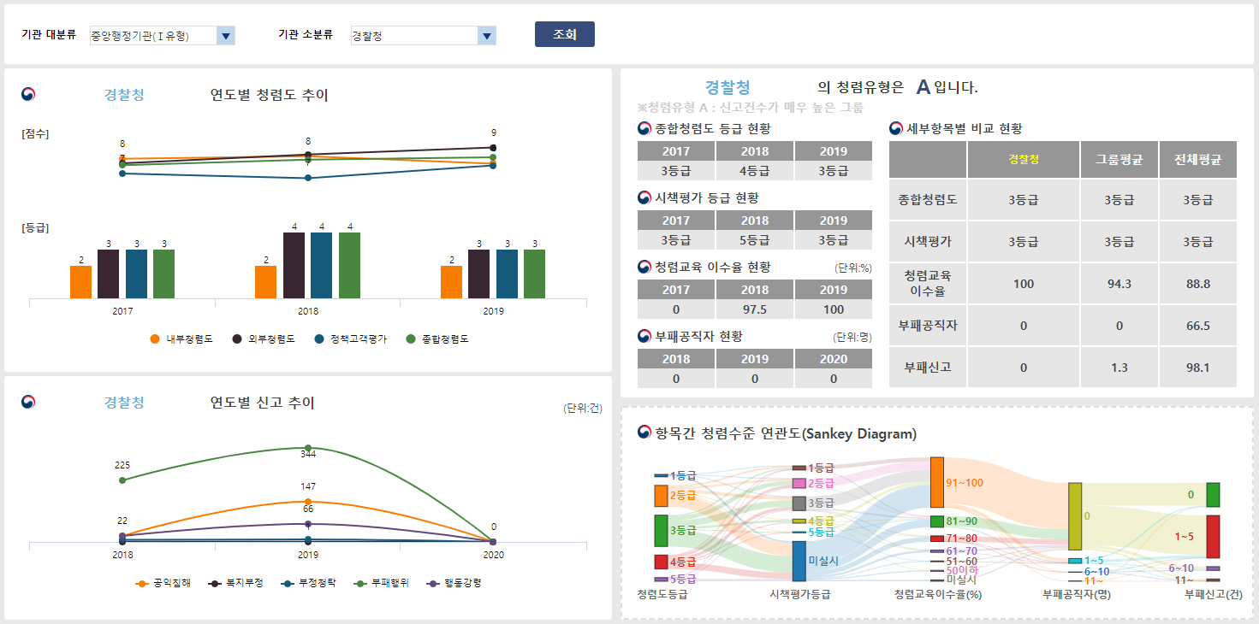
2. Characteristics (ACRC’s perspective)
Data analysis and feedback
< Time-series analysis of ACRC’s integrity policy index
Detection of corruption-prone areas
In-depth analysis of corruption causes
Publication of analysis report
Feedback & improvement of organizations

Slide 14
3. Lessons learned
System Developers
Developers are “designers”, not technicians
should understand related laws and regulations to reduce possible errors in the development procedure
(ex.) Laws subject to public interest whistleblowing protection are continuously added→ Legislative information has been automatically added without the need to manually newly added laws
▶ Training and educational materials should be provided for developers before system development. An officer in charge of answering questions should be designated (with incentives)
Development Result
should provide the existing process online “in an advanced way”
Offline process should not just be moved to an online format, it should be improved with IT technologies
(Ex) A system has been developed with improved functions of transferring reports and sending handling results to relevant public organizations online.
▶ should figure out new technologies to be developed in advance and seek ways to apply them to the system.

Slide 15
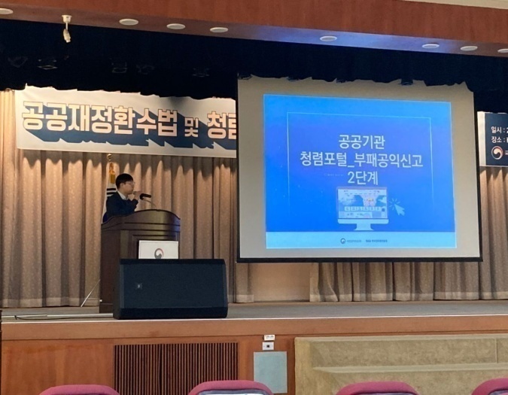
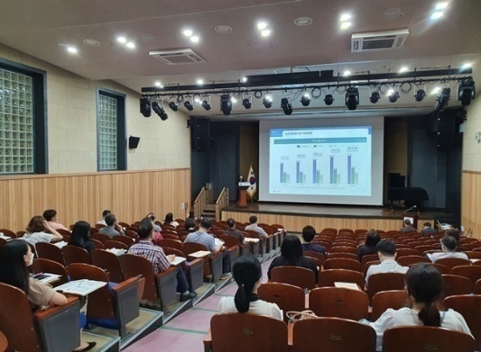
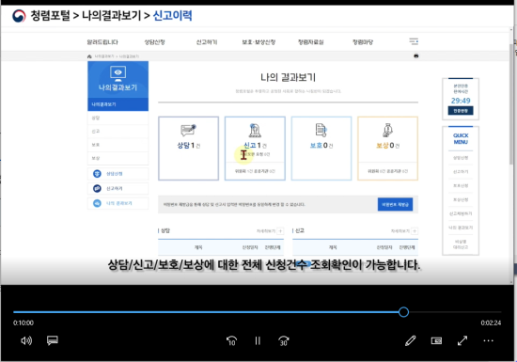
3. Lessons learned
User-friendly
The best system is “the one used without any difficulty”
Build a User Interface(UI) and process that are user-friendly.
(Ex) Reported cases that are nearing the legal deadline are displayed with a different color to make them stand out
▶ Opinions of public and citizens should be collected, and the system should be consistently updated through training and maintenance work
Outreach Regional Education
on Clean Portal (8 times)
System manual video
produced and distributed

Slide 16
Thank You

