Slide 1

Using Technology to Serve Anti-Corruption and Other Society Goals
Dr. Sirilaksana Khoman
Vice Chair, PPGG and Sub-Committee, NACC
Presented at the World Anti-Corruption Conference, “Leveraging Technological Solutions to Detect and Prevent Corruption, organized by International Strategy Institute (ISI) and Rangsit University, October 22, 2024

Slide 2

Using Technology to Serve Anti-Corruption and Other Society Goals
Forest Fire Prevention: Two birds with one stone
Sirilaksana Khoman, Ph.D.
Vice Chair, Foundation for Public Policy and Good Governance (PPGG)
Presented at the World Anti-Corruption Conference,
Rangsit University, October 22, 2024

Slide 3

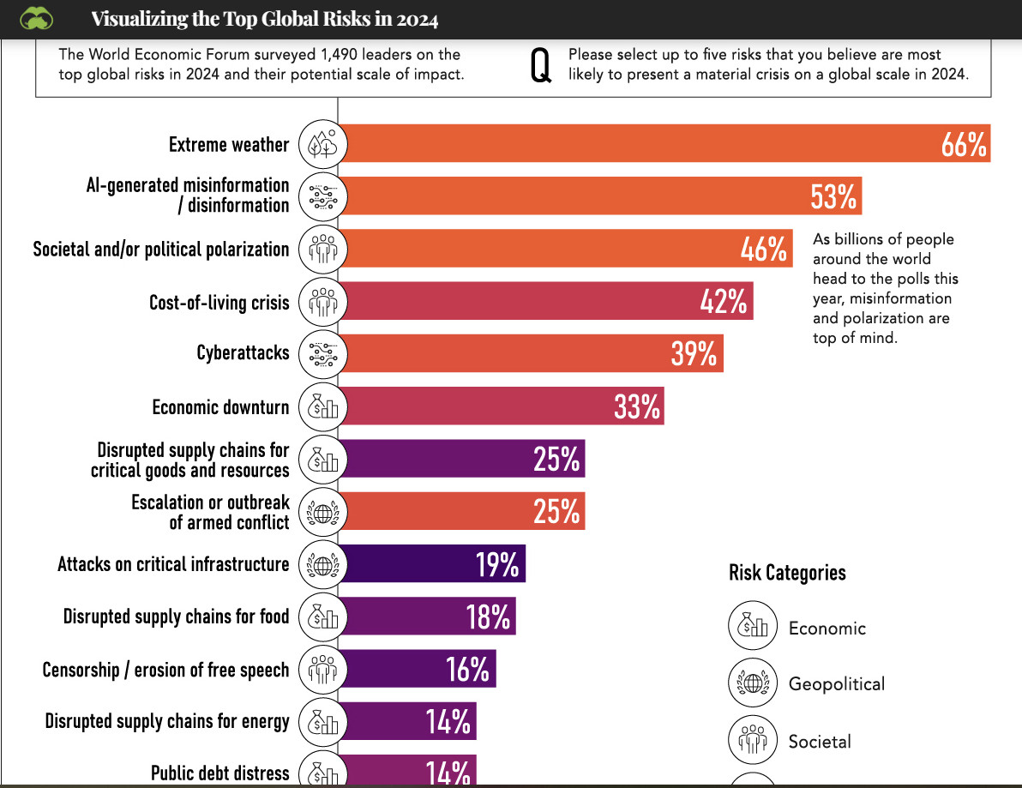

Slide 4
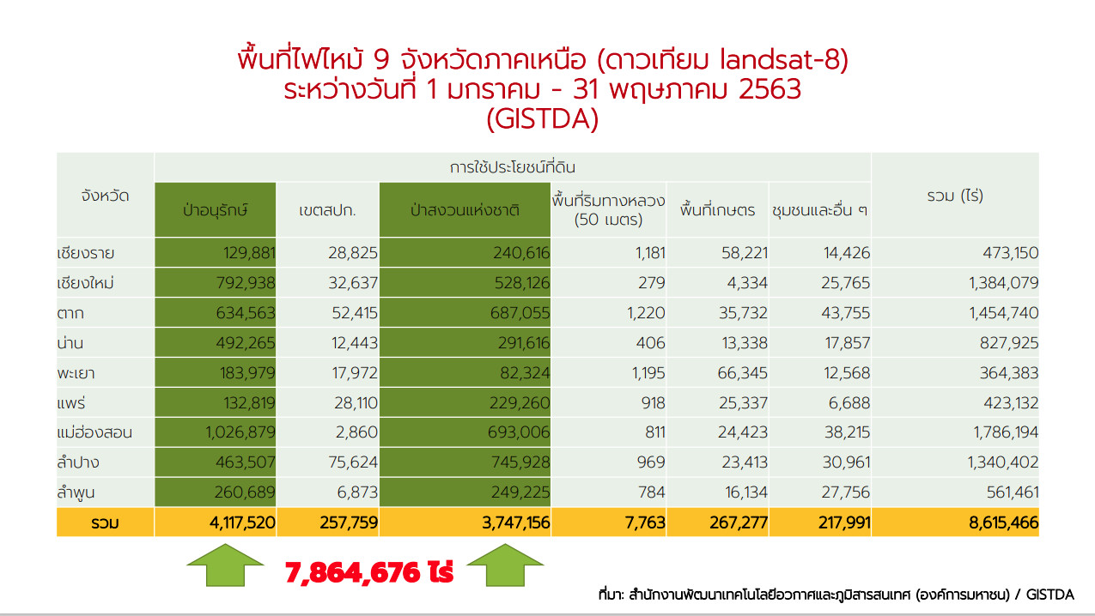

Forest fires in 9 Northern Provinces (satellite landsat-8) between 1 January – 31 May 2020
Protected forests
Reserve forests
1 rai = 0.16 hectares

Slide 5
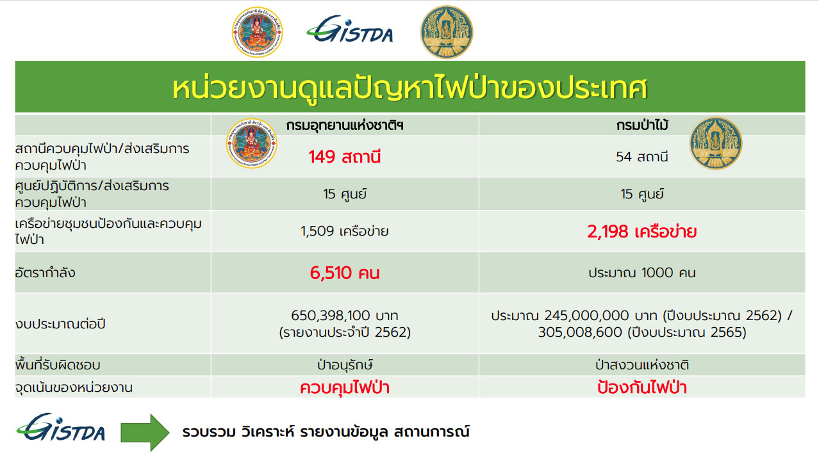
Agencies in charge of dealing with the country’s forest fires
Department of National Parks, Wildlife and Plant Conservation
Forest Department
Manpower
Mission
control
prevention
Predict?

Slide 6
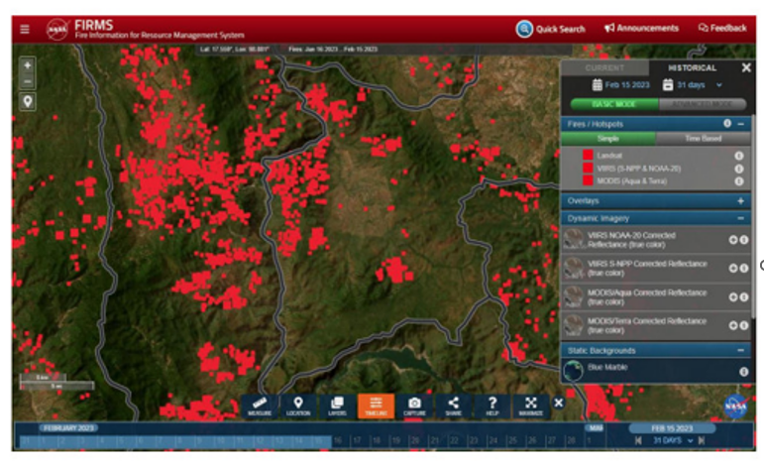
Official Policy: Prohibit burning (Feb – April) / arrests

Slide 7
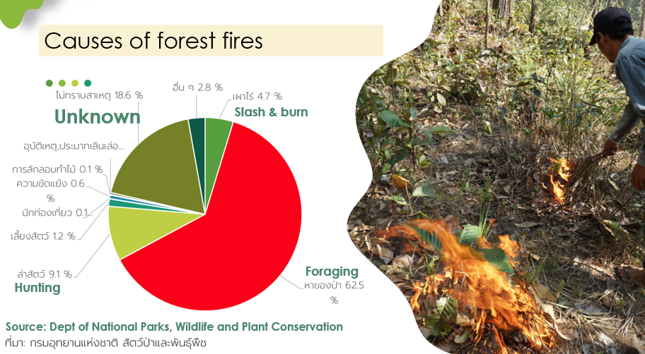

Slide 8

Forest Fire (and Corruption) Prevention using Artificial Intelligence
in line with the community's way of life

Slide 9
What does this have to do with fighting corruption?

Slide 10
The project comprises four components:
(1) sensor installation for fire monitoring and detection, with networks of rural communities trained in installation, maintenance, and monitoring.
(2) training in construction of firebreaks where slash and burn is still the most cost-effective default for low-income farmers, focusing on means to control the spread of fires.
(3) introduction of alternative cultivation and means of livelihood, such as perennial plants and crops, to remove the need for burning.
(4) training in fire investigation.

Slide 11
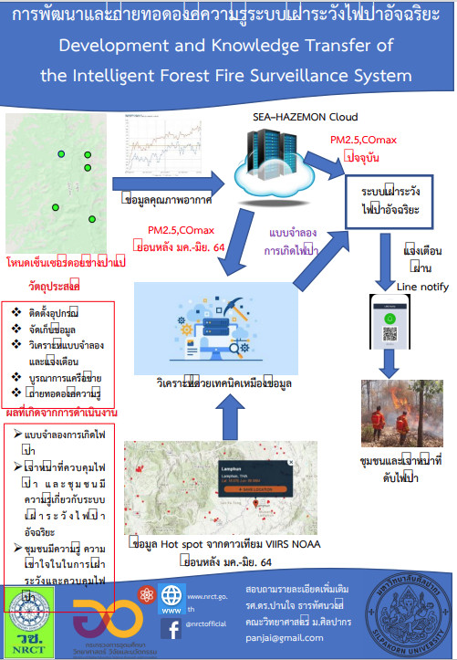
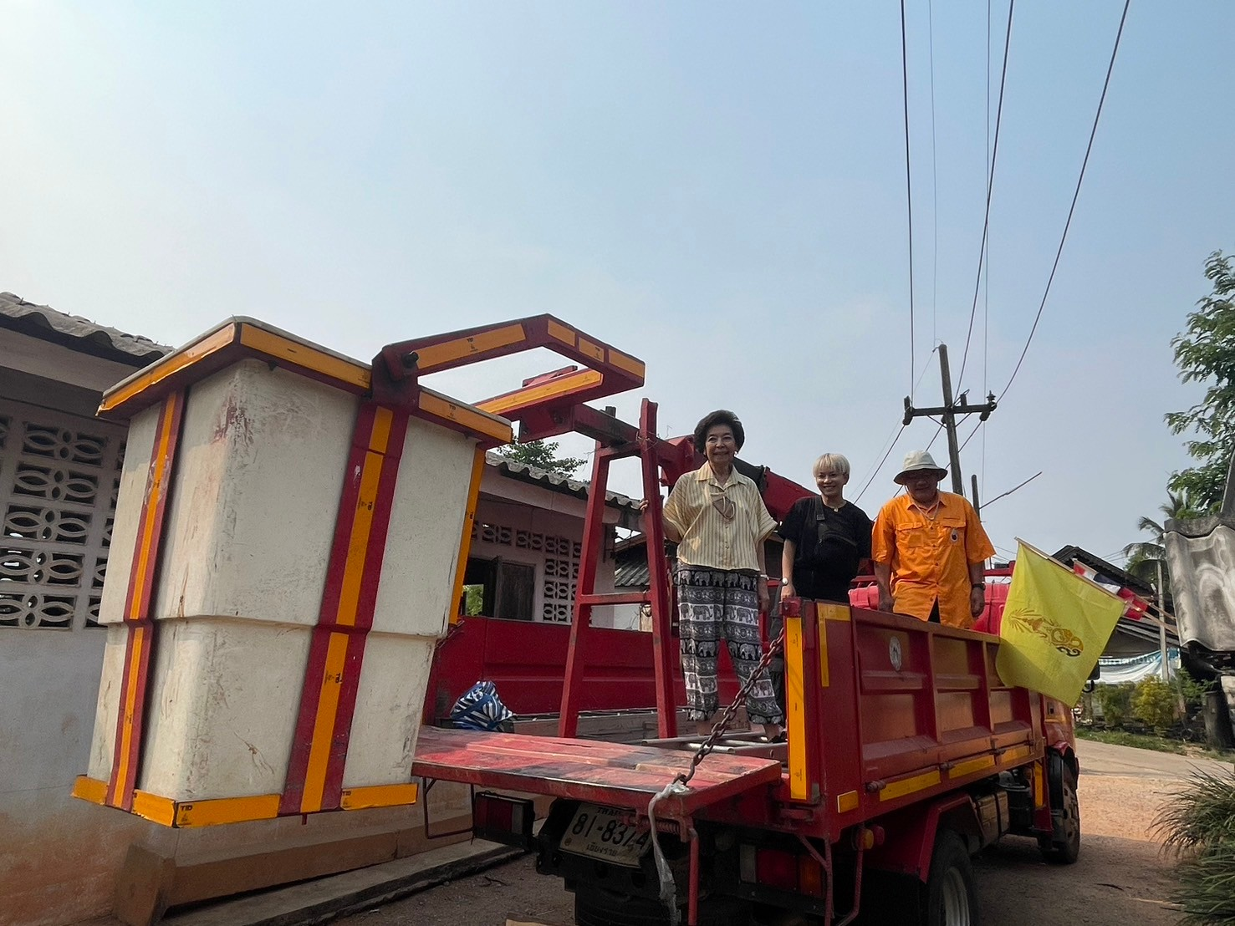
(1) sensor installation

Slide 12
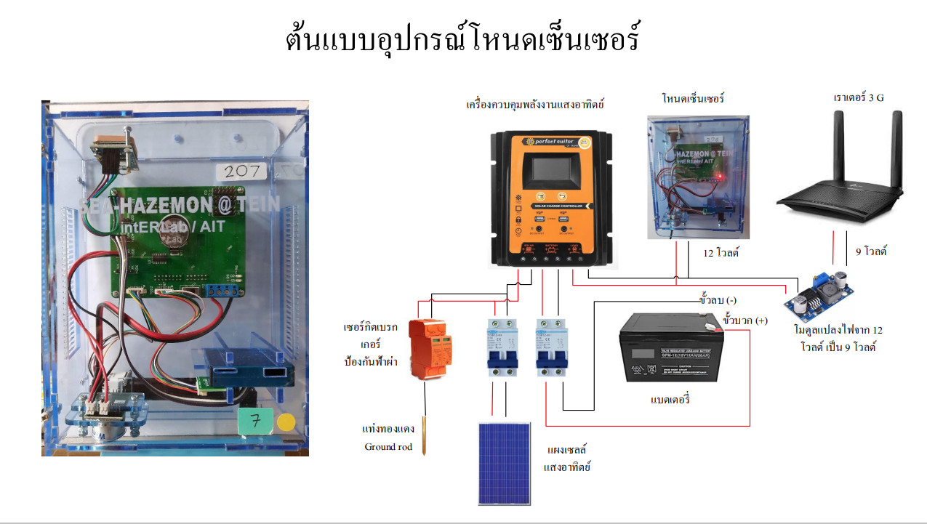
Sensor equipment
Sensor
3G Router
Solar energy controller
Circuit breakers
Transformer
battery
Solar panel
Ground rod

Slide 13
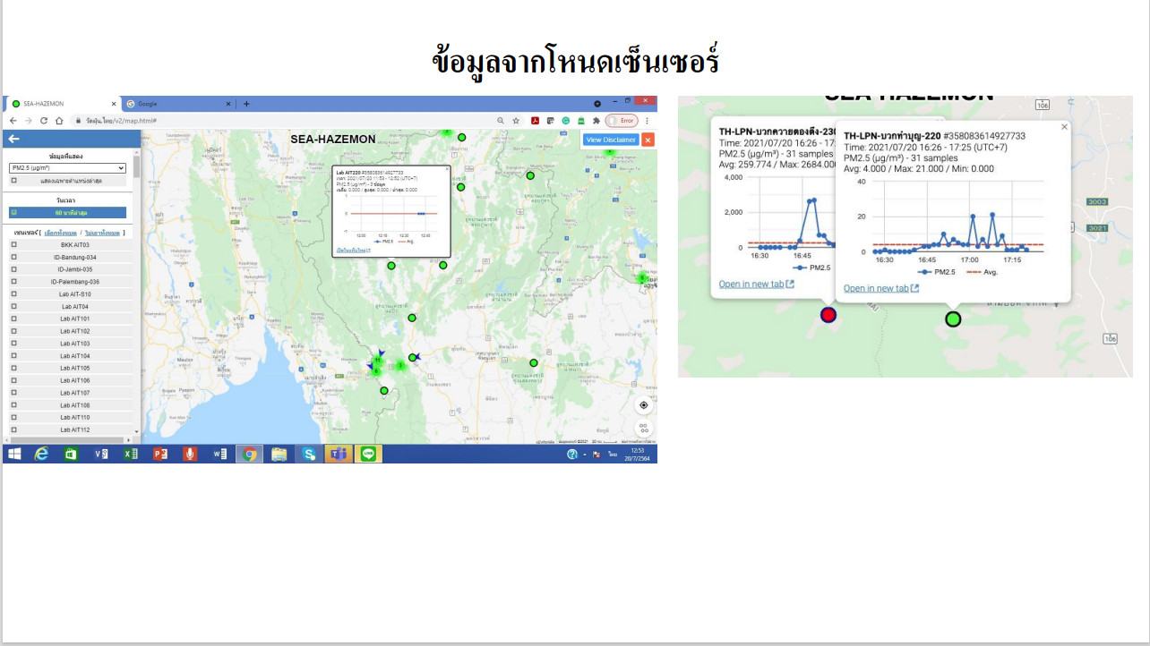
Data from sensors transmitted to mobile phone of network members

Slide 14
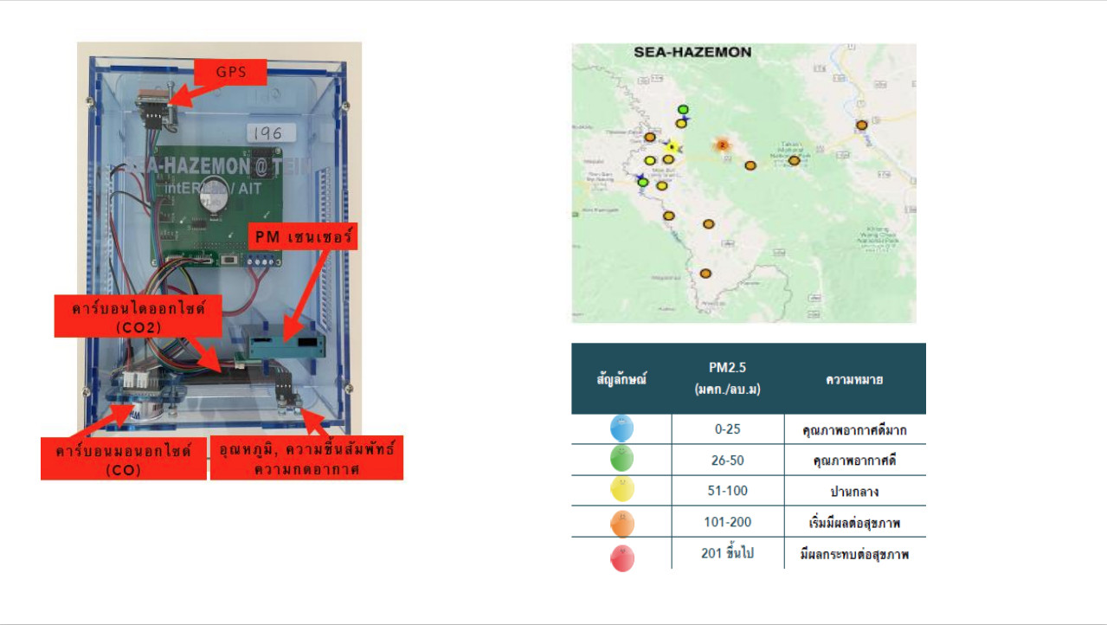
GPS
PM 2.5
CO2
Temperature, relative humidity, atmospheric pressure
CO

Slide 15
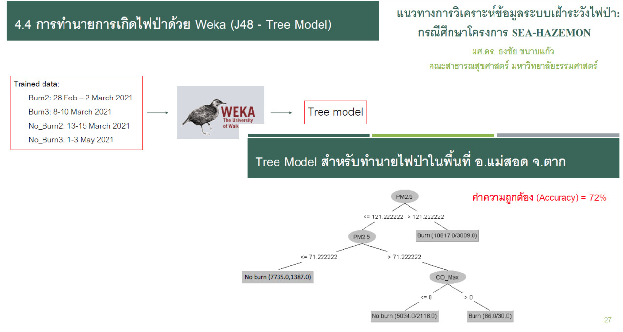
Prediction of fire ignition with
for prediction of fire ignition, Mae Sod, Taak

Slide 16
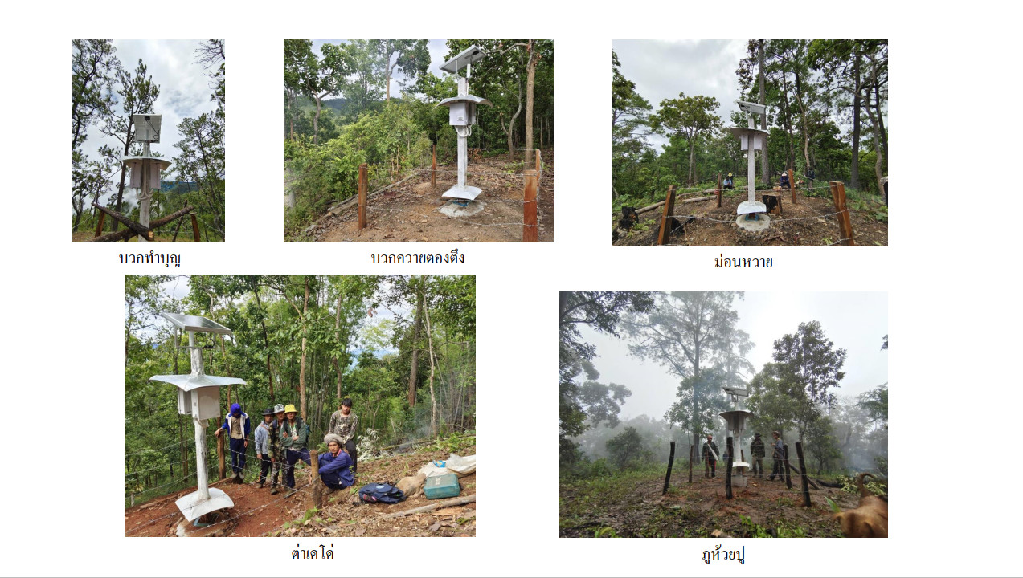

Slide 17
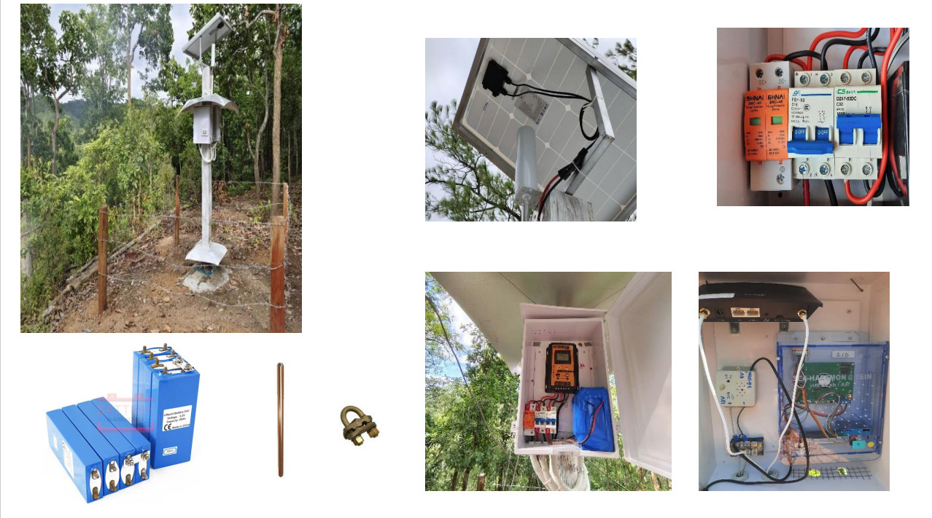

Slide 18
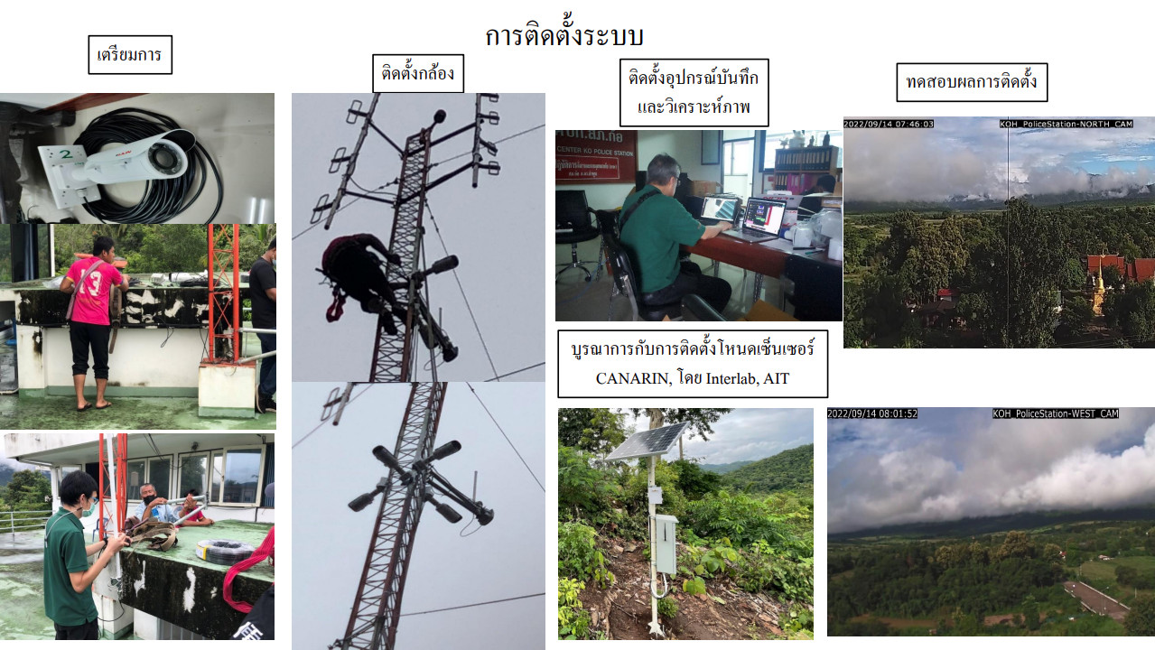

Slide 19
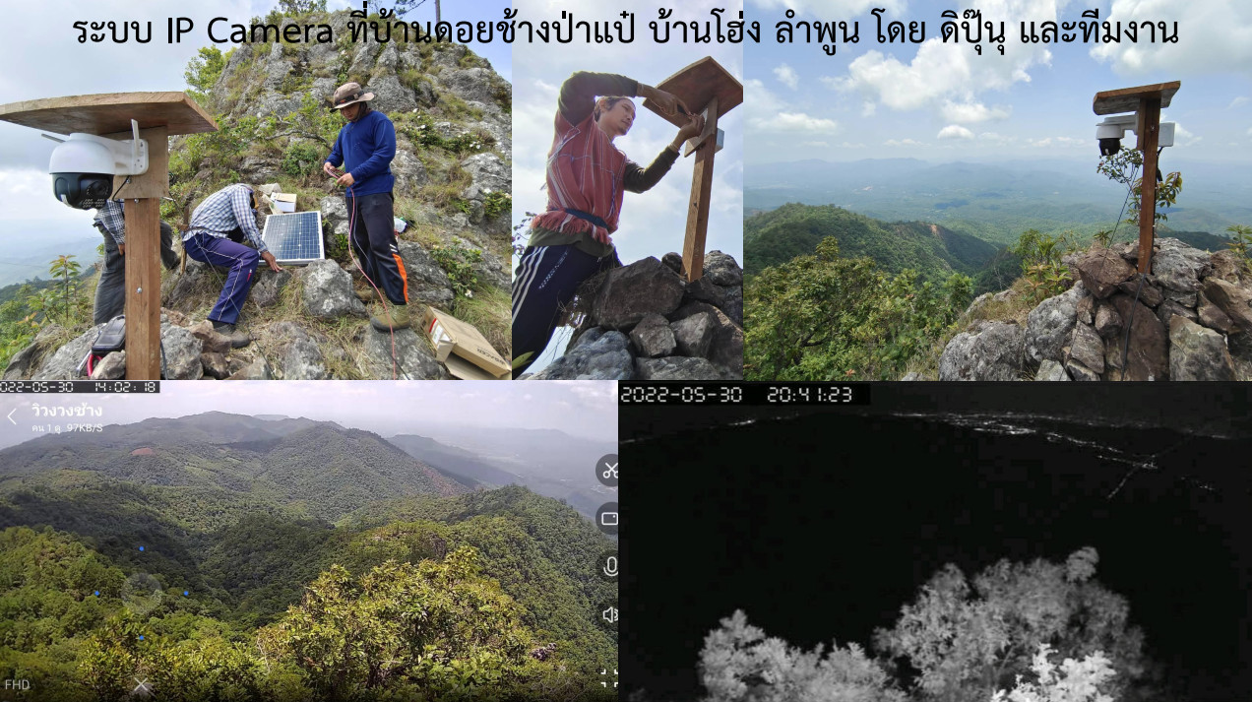

Slide 20
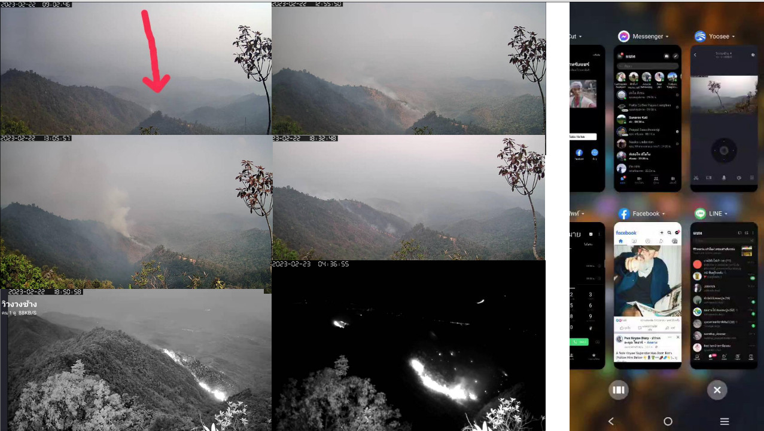

Slide 21
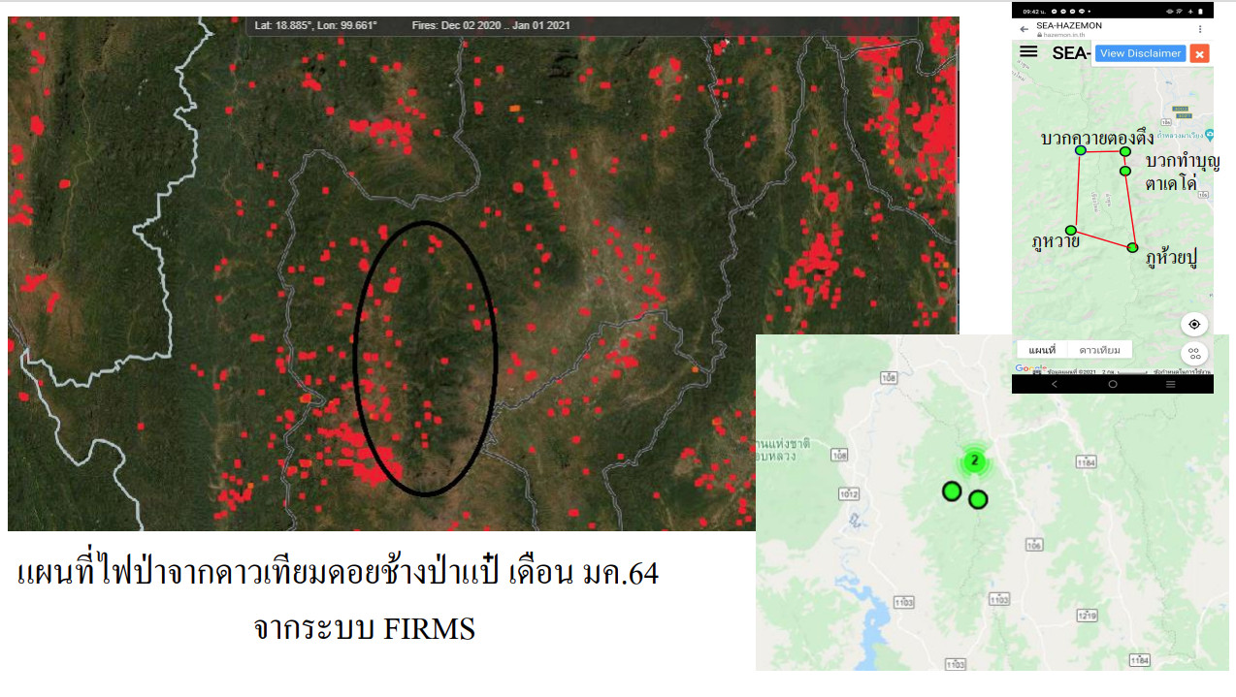
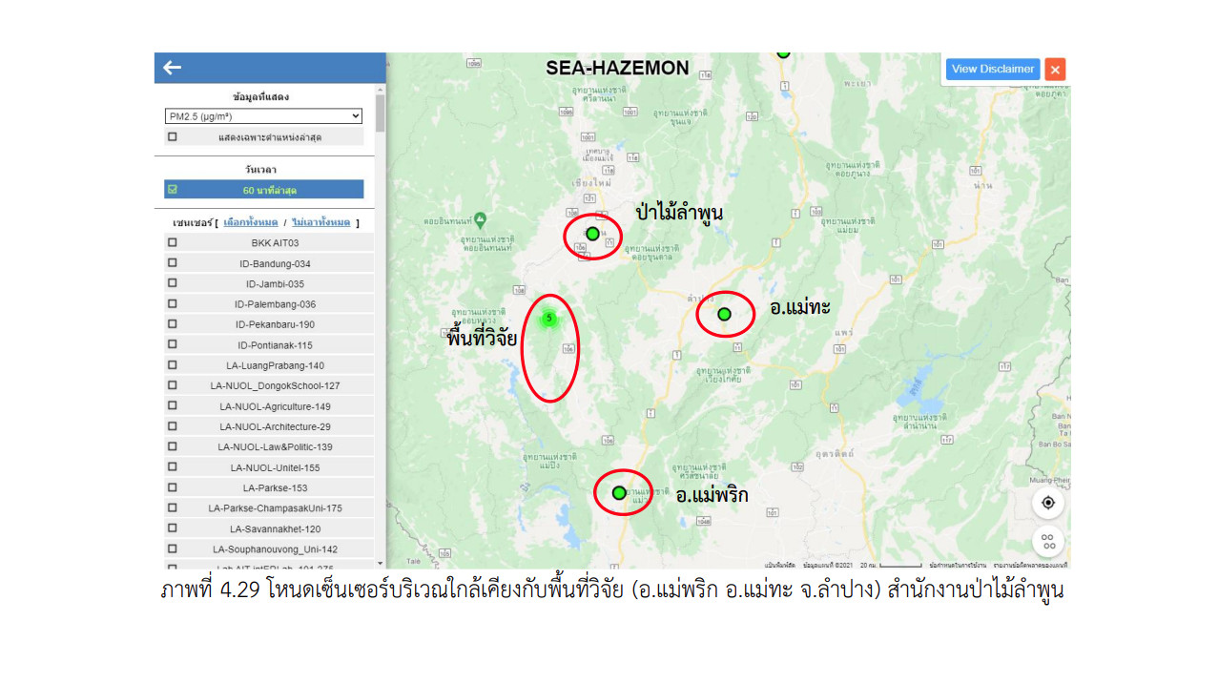
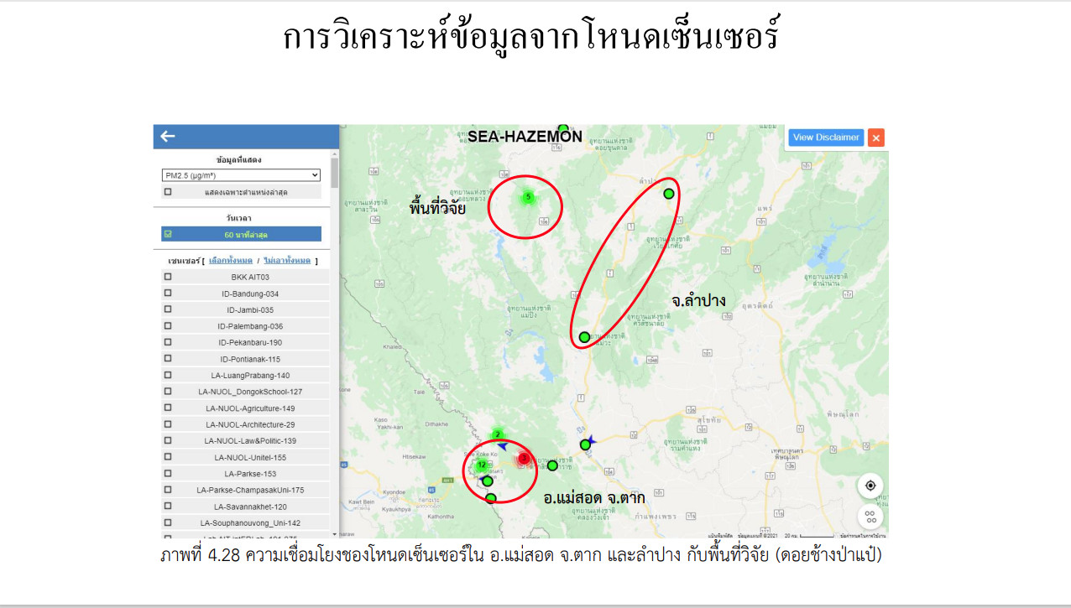

Slide 22
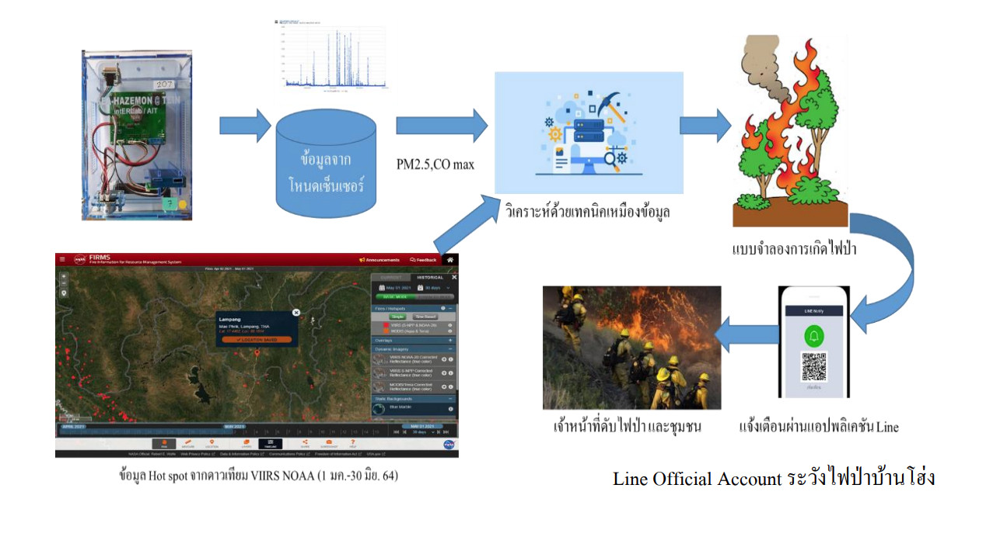

Slide 23
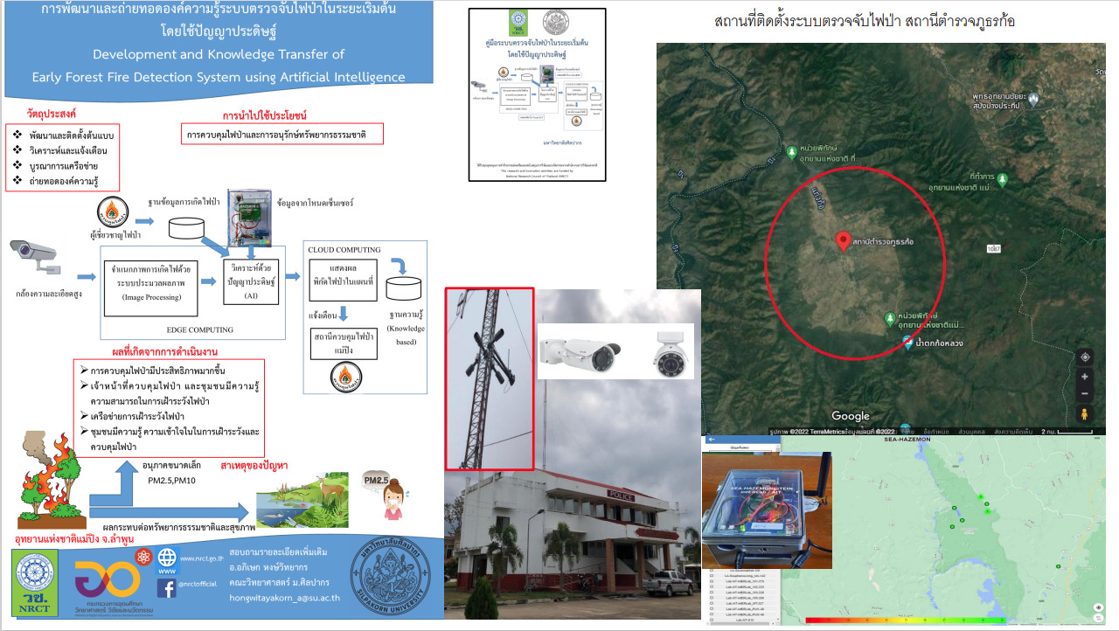

Slide 24
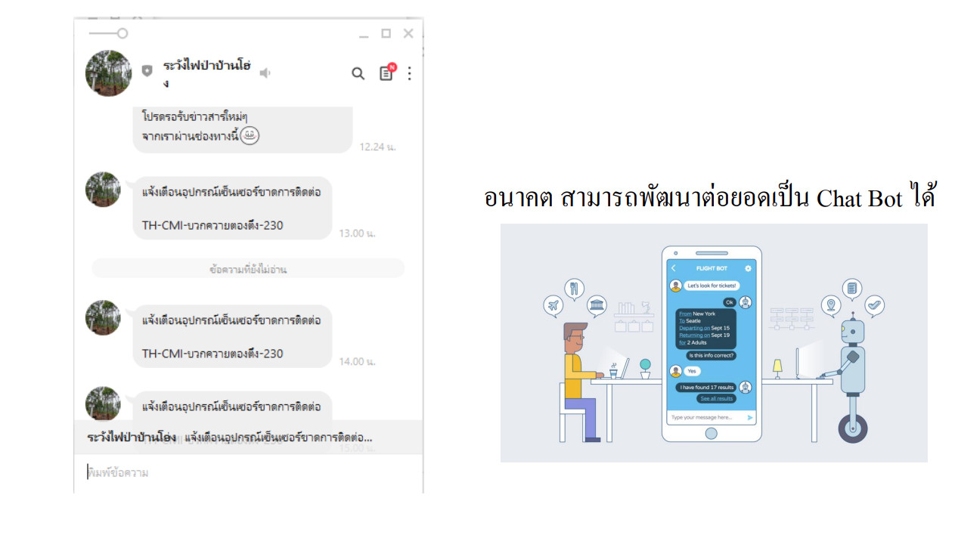

Slide 25
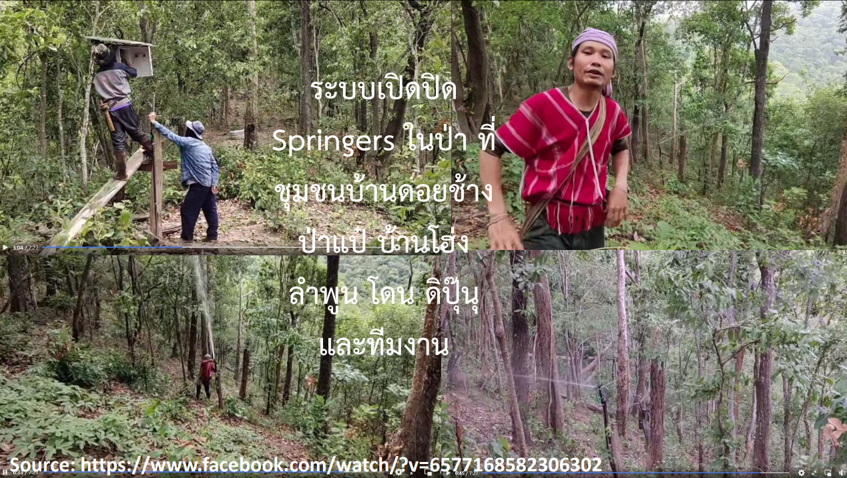
Sprinklers

Slide 26
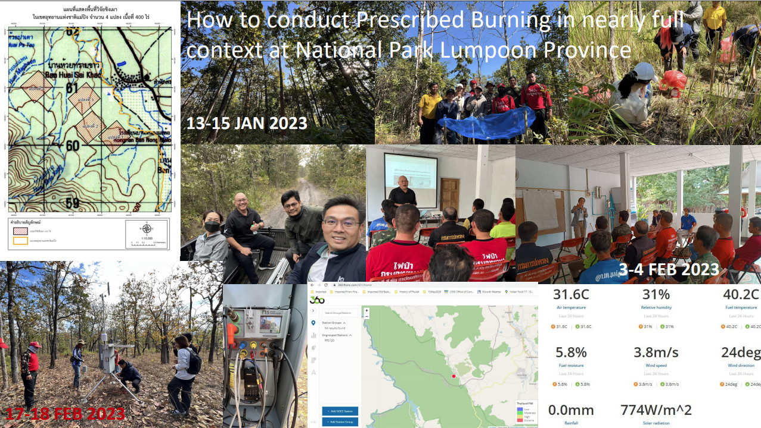

Slide 27
Bottom line: Fires due to corruption can be eliminated

