Slide 1
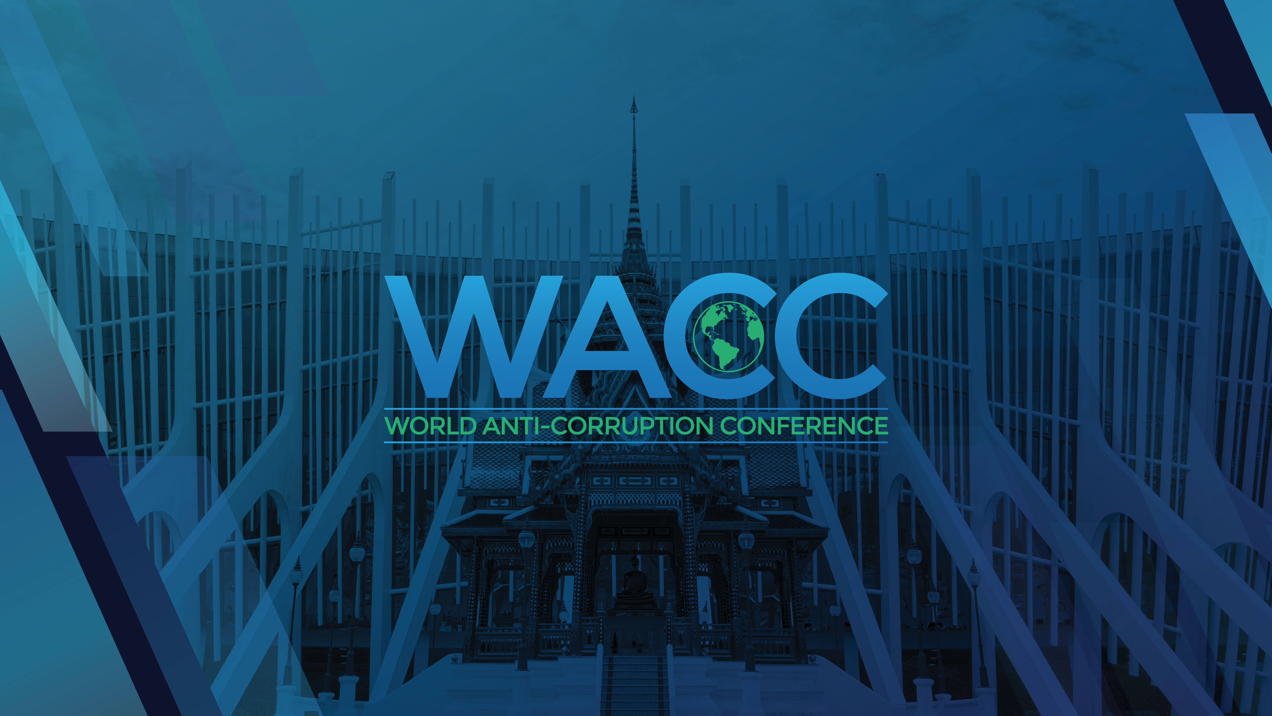

Slide 2
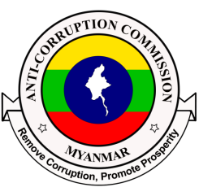
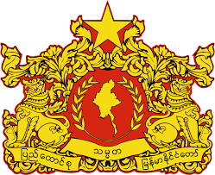
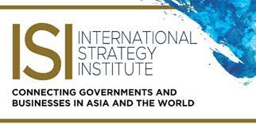
REPUBLIC OF THE UNION OF MYANMAR
ANTI-CORRUPTION COMMISSION
STRENGTHENING ANTI-CORRUPTION LEGISLATION AND JUDICIAL INDEPENDENCE: BUILDING ROBUST LEGAL FRAMEWORK
By
H.E. Mr. Kyaw Win Thein
Commissioner
Anti-Corruption Commission Myanmar
Bangkok, Thailand
22nd October 2024

Slide 3
United Nations Convention Against Corruption
Myanmar
Signed in 2005
Ratified on December 20, 2012
165th member of UNCAC
Chapter II Preventive Measures
Chapter III Criminalization and Law Enforcement
Chapter IV International Cooperation
Chapter V Asset Recovery
3

Slide 4
Corruption Related Domestic Law in Myanmar
The Penal Code (1860)
Myanmar Government Secrets Act (1923)
The Public Property Protection Act (1947)
Special Investigation Department Act (1951)
The Defense Services Act (1959)
Property Protection Act Relating to Matters (1963)
Income Tax Law (1974)
Law on Foreign Fishing Vessels (1989)
Myanmar Marine Fisheries Law (1990)
Commercial Tax Law (1990)
The Saving Bank Law (1992)
Narcotic Drugs and Psychotropic Substances Act (1993)
Control of Anti- Money Laundering Law (2002)
Anti -Trafficking in Persons Act (2005)
Pyithu Hluttaw Election Law (2010)
National Assembly Election Law (2010)
The Regional Hluttaw or State Hluttaw Election Law(2010)
The Central Bank of Myanmar Law (2013)
The Civil Service Law (2013)
Anti-Money Laundering Law (2014)
Myanmar Fire Brigade Law (2015)
The Forest Law(2018)
Myanmar Police Force Act (2022)
4

Slide 5
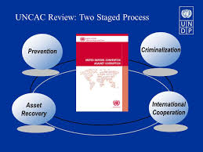
UNCAC member (1st Cycle and 2nd Cycle)
1st Cycle ; Reviewing State Party, had to review Cambodia together with Togo, and was reviewed by Thailand and Burundi as the Under-Reviewed State. (34 recommendations)
2nd Cycle ; Review process, Myanmar, as the Reviewing State Party, had to review Nigeria in conjunction with Ivory Coast. Myanmar also had to review the United Arab Emirates (UAE) in collaboration with Kuwait. In turn, Myanmar was reviewed by Iraq and Uzbekistan as the Under-Reviewed State. (35 recommendations)
5

Slide 6
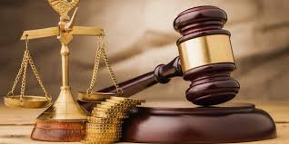
Characteristic of Effective Anti-Corruption Laws and Legal System
Clean Definition and Scope
Strong Legal Framework
Independent
Whistle-blower Protection
Transparency
Accountability
International Relation
Training and Education
Enforcement Mechanism
Monitoring and Evaluation
6

Slide 7
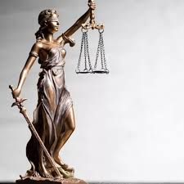
Generate Independent and Effectiveness of Judicial System
Specifically of Power
Judicial Opportunity
Security of Tenure
Financial Independent
Code of Content
Public Accountability
Protection for External
International Relation
Awareness and Education
7

Slide 8
Anti-Corruption Law
01
Assets Recovery
02
Countering the Financing of Terrorism
03
Anti- Money Laundering
Anti-Corruption
Law
04
Mutual Legal Assistant
05
Witness Protection
06
Whistleblower Protection Law
Financial Institution Law
Central Bank Law
07
8

Slide 9
Legal Review
01
Amendment
New Law
02
LEGAL REVIEW
03
Deleted
Concentrate
04
9

Slide 10
Judicial System
07
Pre-trail Briefing
(Recall / Note Guide)
Video Conferencing
(Jail, Oversea) (Hearing System)
06
05
Law Enforcement and Relevant Agency
Independent
04
03
Formation of Court and Judicial
Political Will
02
Constitution
01
JUDICIAL SYSTEM
10

Slide 11
Taking Actions
From 2014 to September 2024,
The Commission received complaints 37374
Investigations cases 321
Transfer to relevant agencies cases 7015
Person prosecution under the Anti-Corruption Law,
Former political post holder 67
High-ranking officials 22
Officials 99
Staff 86
Public servant 18
Individuals 45
In Total Person 337
11

Slide 12
Taking Actions
Under the AC Law section 30(b) transfer to relevant agencies 416 person(departmental)
Under the AC Law section 16(m) transfer to relevant agencies 2553 person( Regional Govt)
Confiscated and deposited as public funds,
Myanmar Kyats 26,430.877 million
U$ Dollars 4,044,640.35 (4 million)
Recover state funds,
Myanmar Kyats 156,169.524 million
Euro 3,052,665 (3 million)
12

Slide 13
Recommendations;
Strong Legal Framework
Reviewing existing law every 4 years.
Follow up recommendation of UNCAC country visit
Complete the UNCAC chapter 2,3,4,5
Strong Institution
Core and key function
Effective implementation
Evaluation and monitory
13

Slide 14
Recommendations;
International / Internal Cooperation
Effectiveness
Concise mechanism
Wide/spread network
Deep relations among LEAs
Capacity Building
Government issue and facility
International norms
Ethic, code of conduct
Capability among communities
Political Will
14

Slide 15
CONTACT INFO
H.E. Kyaw Win Thein
Commissioner
Anti-Corruption Commission
The Republic of The Union of Myanmar
Office No. 56, Zayahtani Road, Nay Pyi Taw
Office : +95-67-8103340 , Mobile: +95-9-5075682, +95-5-261179324
kyawwinthein5075682@gmail.com
www.accm.gov.mm
15

Slide 16
THANK YOU
16

