Slide 1
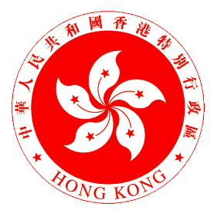
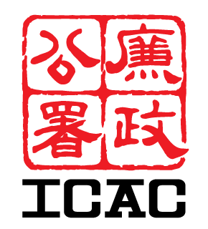
Hong Kong, China

Slide 2
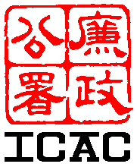
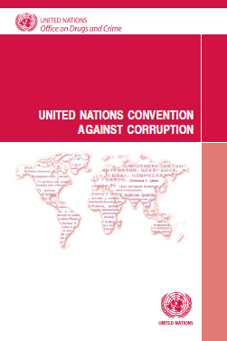
United Nations Convention against Corruption
Chapter II
Chapter IV
Chapter VI
Preventive
Measures
International
Cooperation
Technical Assistance
Information Exchange
?
i
Chapter III
Chapter V
Chapter VII
Criminalisation
Law Enforcement
Asset
Recovery
Implementation

Slide 3
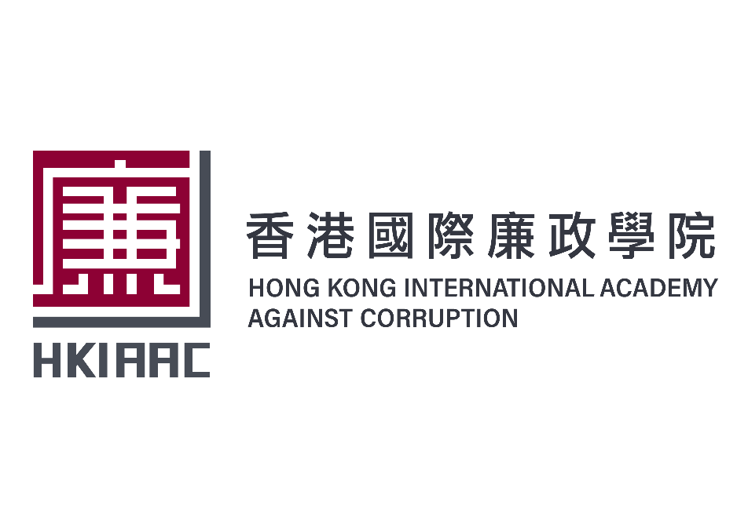
Our Mission
To establish an international platform to foster anti-corruption efforts and advance the global anti-corruption cause

Slide 4
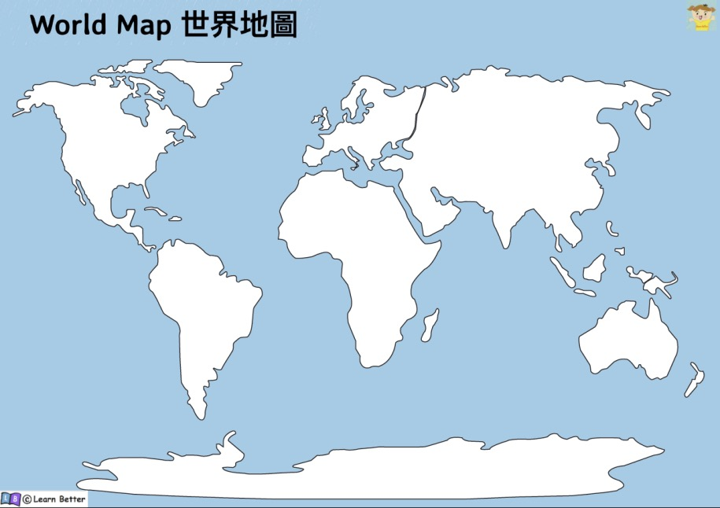
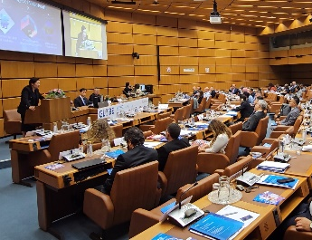
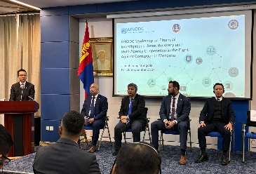
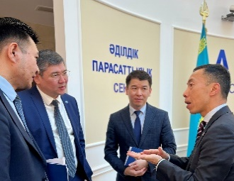
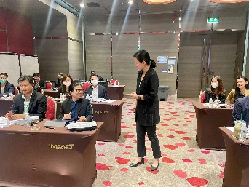
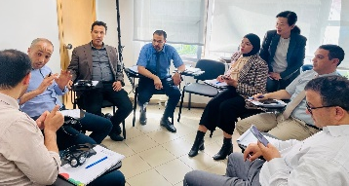
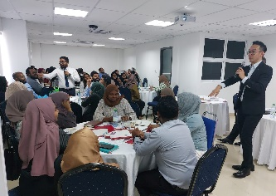
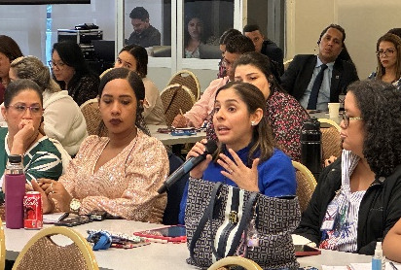
Australia
Bhutan
Brunei
Botswana
Cambodia
Cook Islands
Darussalam
Fiji
Indonesia
Malaysia
Mali
Mongolia
Nigeria
Kenya
Pakistan
Saudi Arabia
South Africa
Singapore
South Africa
Thailand
Philippines
Uganda
Vietnam
Zimbabwe
UNODC
Australia
Bhutan
Brunei
Botswana
Cambodia
Cook Islands
Darussalam
Fiji
Indonesia
Malaysia
Mali
Mongolia
Nigeria
Kenya
Pakistan
Saudi Arabia
South Africa
Singapore
South Africa
Thailand
Philippines
Uganda
Vietnam
Zimbabwe
UNODC
Australia
Bhutan
Brunei
Botswana
Cambodia
Cook Islands
Darussalam
Fiji
Indonesia
Malaysia
Mali
Mongolia
Nigeria
Kenya
Pakistan
Saudi Arabia
South Africa
Singapore
South Africa
Thailand
Philippines
Uganda
Vietnam
Zimbabwe
UNODC
Mongolia
GlobE Network UNODC (Vienna)
Anti-corruption Agency of the Republic of Kazakhstan
NTA (Greece)
Regional training workshop in Central Asia
PACC (Thailand)
International training
INPPLC (Morocco)
OCLEI (Mali)
Anti-Corruption Commission (Maldives)
AGPO (Panama)
MICAC (Martius)
SIU (South Africa)
KPK (Indonesia)
Australia
Bhutan
Brunei
Botswana
Cambodia
Cook Islands
Darussalam
Fiji
Indonesia
Malaysia
Mali
Mongolia
Nigeria
Kenya
Pakistan
Saudi Arabia
South Africa
Singapore
South Africa
Thailand
Philippines
Uganda
Vietnam
Zimbabwe
UNODC
Australia
Bhutan
Brunei
Botswana
Cambodia
Cook Islands
Darussalam
Fiji
Indonesia
Malaysia
Mali
Mongolia
Nigeria
Kenya
Pakistan
Saudi Arabia
South Africa
Singapore
South Africa
Thailand
Philippines
Uganda
Vietnam
Zimbabwe
UNODC

Slide 5
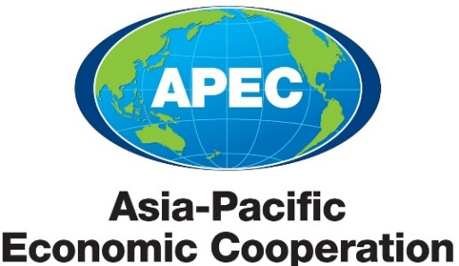

Slide 6
Where we stand
Indicator/Survey | Indicator | Hong Kong’s Ranking | No. of Places Surveyed
Transparency International Corruption Perceptions Index 2023 | Corruption Perceptions Index | 14th | 180
World Justice Project Rule of Law Index 2023 | Rule of Law Index “Absence of Corruption” | 23th “9th” | 142
International Institute for Management Development World Competitiveness Yearbook 2023 | Competitiveness “Bribery & Corruption Do Not Exist” | 5th “4th” | 64

Slide 7
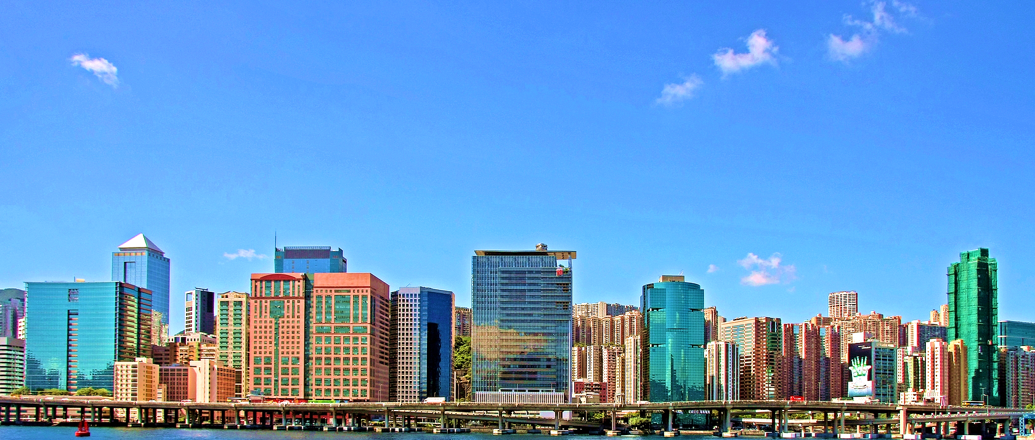
Paul LAU
ICAC, Hong Kong, China
pchlau@ops.icac.org.hk
Thank you

