Slide 2
CROSS BORDER ANTI-CORRUPTION
EFFORTS IN ASIA PACIFIC:
ENHANCING REGIONAL COOPERATION
BY: CHAIRMAN GRECO BELGICA, MNSA

Slide 3
INTRODUCTION
CORRUPTION IS AKIN TO A MALIGNANT TUMOR THAT DRAWS ITS STRENGTH FROM ANONIMITY . THUS, IT MUST BE DETECTED (I.E., EXPOSED) AND ADDRESSED TO SAVE SOCIETY FROM THE CERTAINTY OF DEATH AND DECAY. THE SPREAD OF THIS LIFE-THREATENING ILLNESS HAS EXPONENTIALLY INCREASED WITH THE USE OF TECHNOLOGY. OUR REGION IS LIKE THE HUMAN BODY, UNLESS WE UNITE AND CONCERTEDLY RESOLVE THIS SOCIAL DISEASE, THIS CANCER WILL SPREAD WITHIN OUR REGION TO DESTROY OUR COUNTRIES AND OUR PEACEFUL CO-EXISTENCE.

Slide 4
PROPOSED SOLUTION:
THE PHILIPPINE EXPERIENCE
ACKNOWLEGING THAT PACC NEEDS TO LEARN
FROM THE BEST PRACTICES OF OTHER COUNTRIES
ON ANTI-CORRUPTION EFFORTS,
WE FIRST WENT TO CHINA IN DECEMBER 2018.
THE NATIONAL SUPERVISION COMMISSION HEADED BY
LI SHU LEI HOSTED A DINNER AND WE LEARNED …..

Slide 5
THAT CHINA ALSO HAVE A PROBLEM:
THEY WANT TO CATCH FUGUTIVES WHO
HIDE IN OTHER COUNTRIES. WITH TECHNOLOGY,
THEY DISCOVERED THAT THE TWO
MOST WANTED CORRUPT OFFICIALS
ARE HIDING IN THE PHILIPPINES.
THEY REQUESTED US TO HELP
IN THE ARREST AND DEPORTATION OF THESE
CRIMINALS.

Slide 6
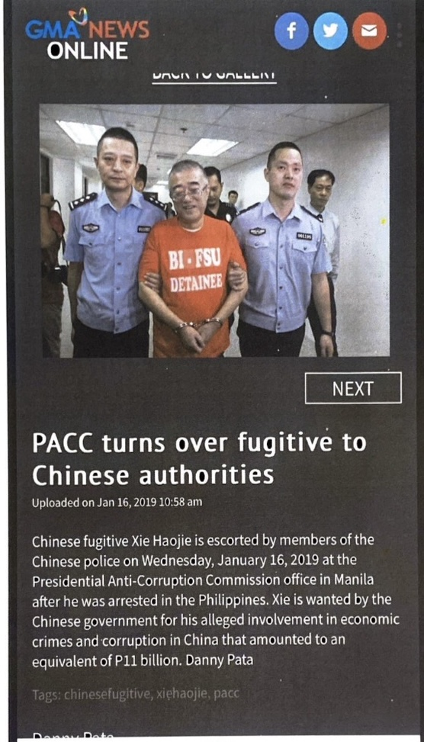
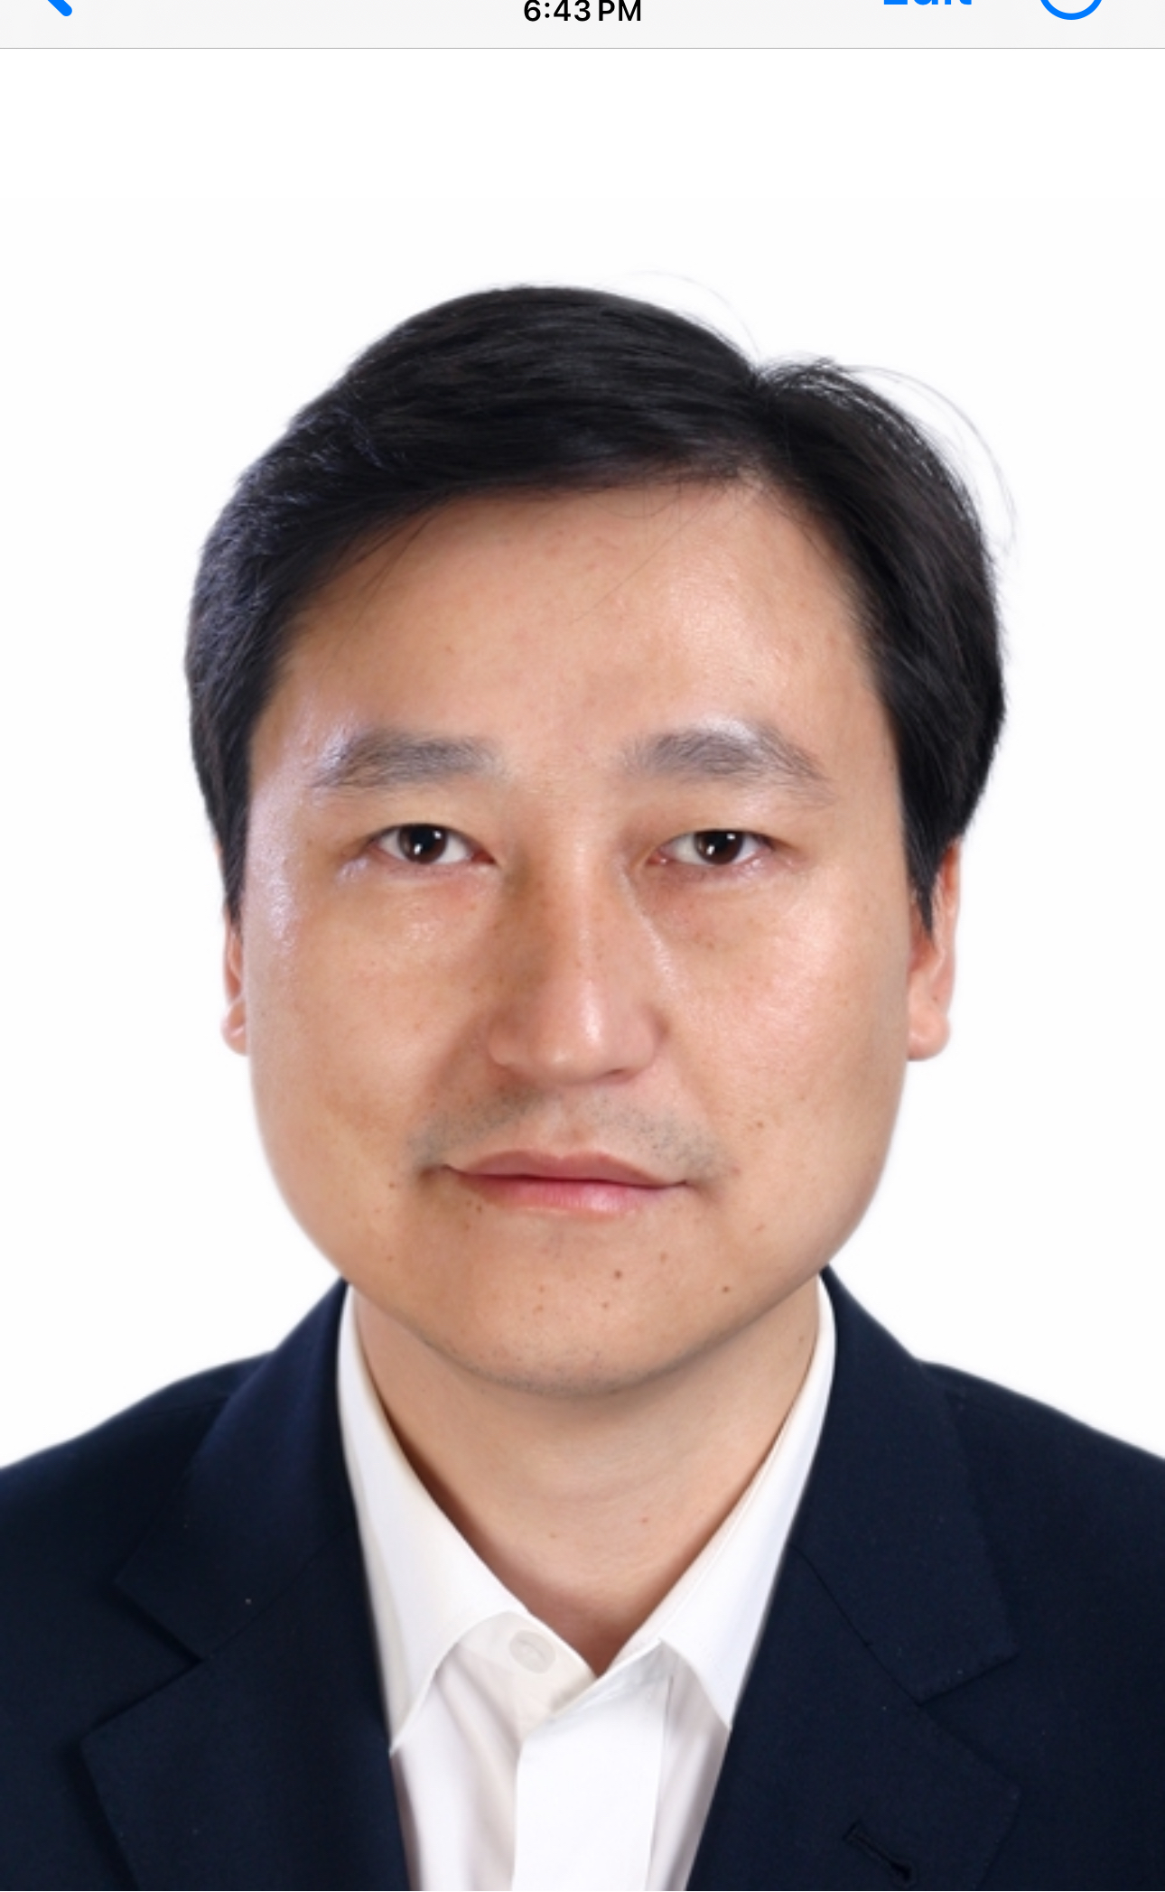
JAN 16, 2019
Fugitive Xie Haojie
Was arrested
ONE DOWN,
ONE TO GO!
He was arrested and
Deported to China in
2021, after a pursuit
that began in 2011

Slide 7
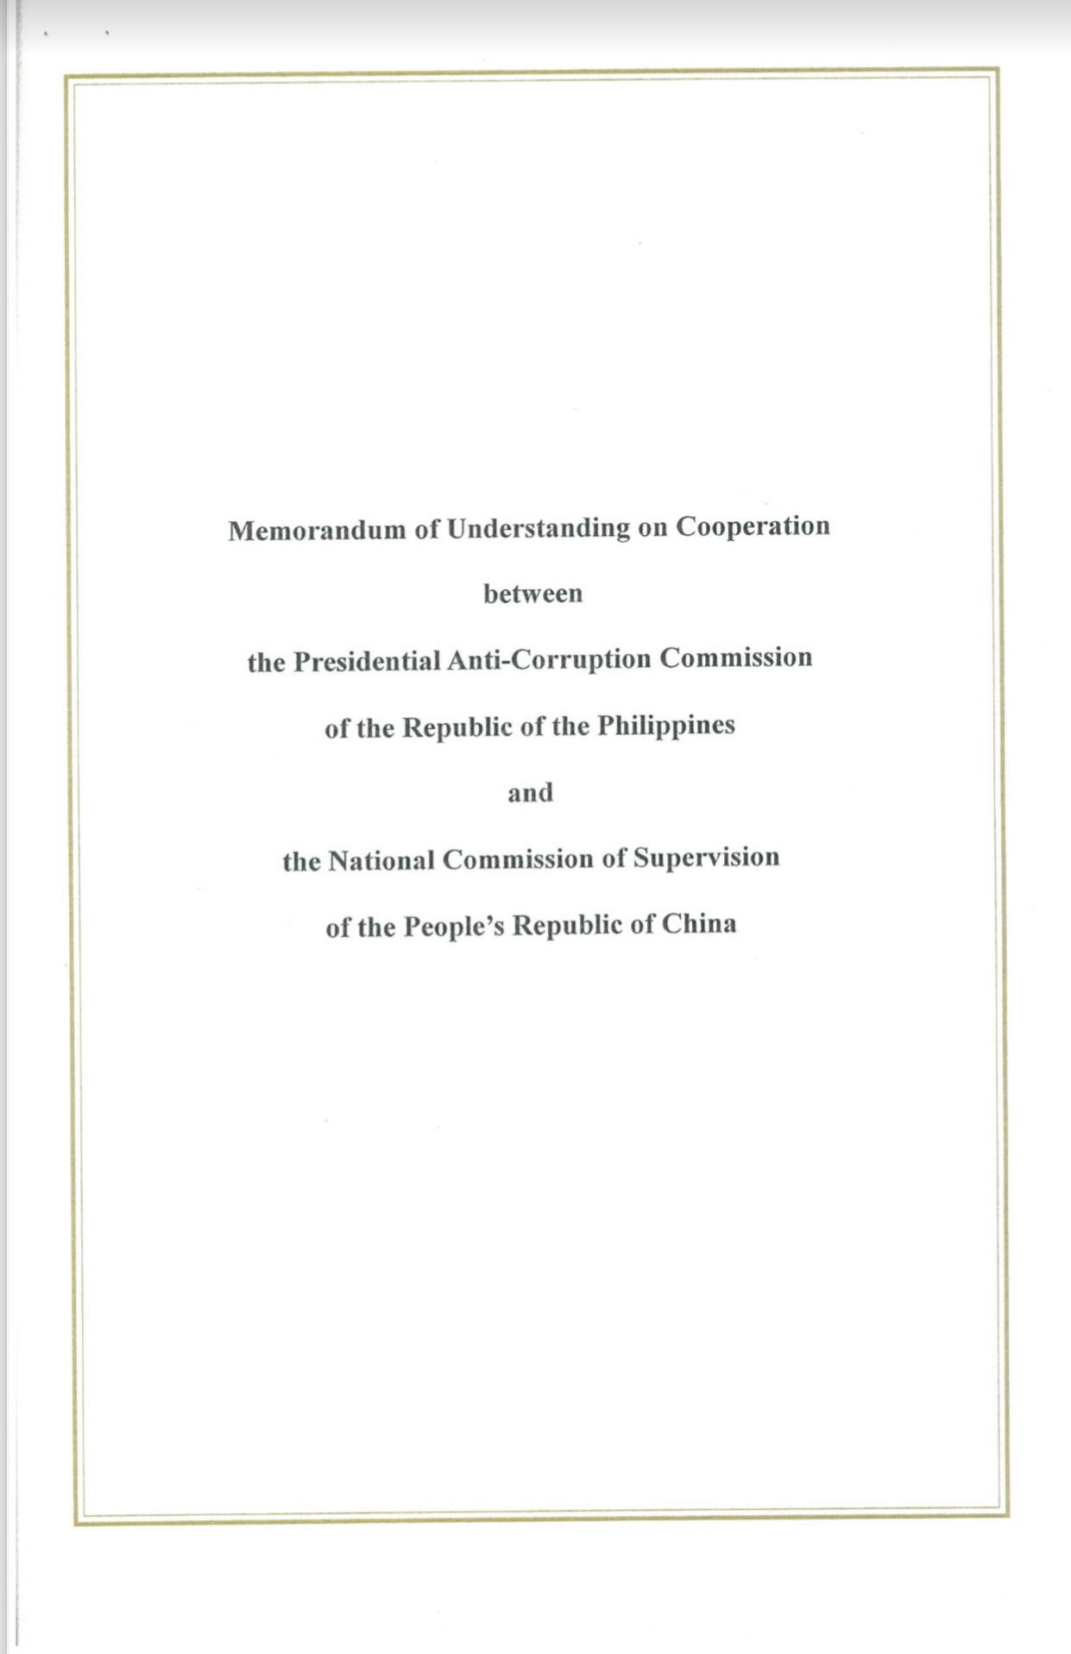
This paved
the way to …..
The signing of a
Memorandum of Understanding
on Cooperation between
PACC and the National Commission of Supervision
In April 2019 at the Belt and Road
Initiative in Beijing.

Slide 8
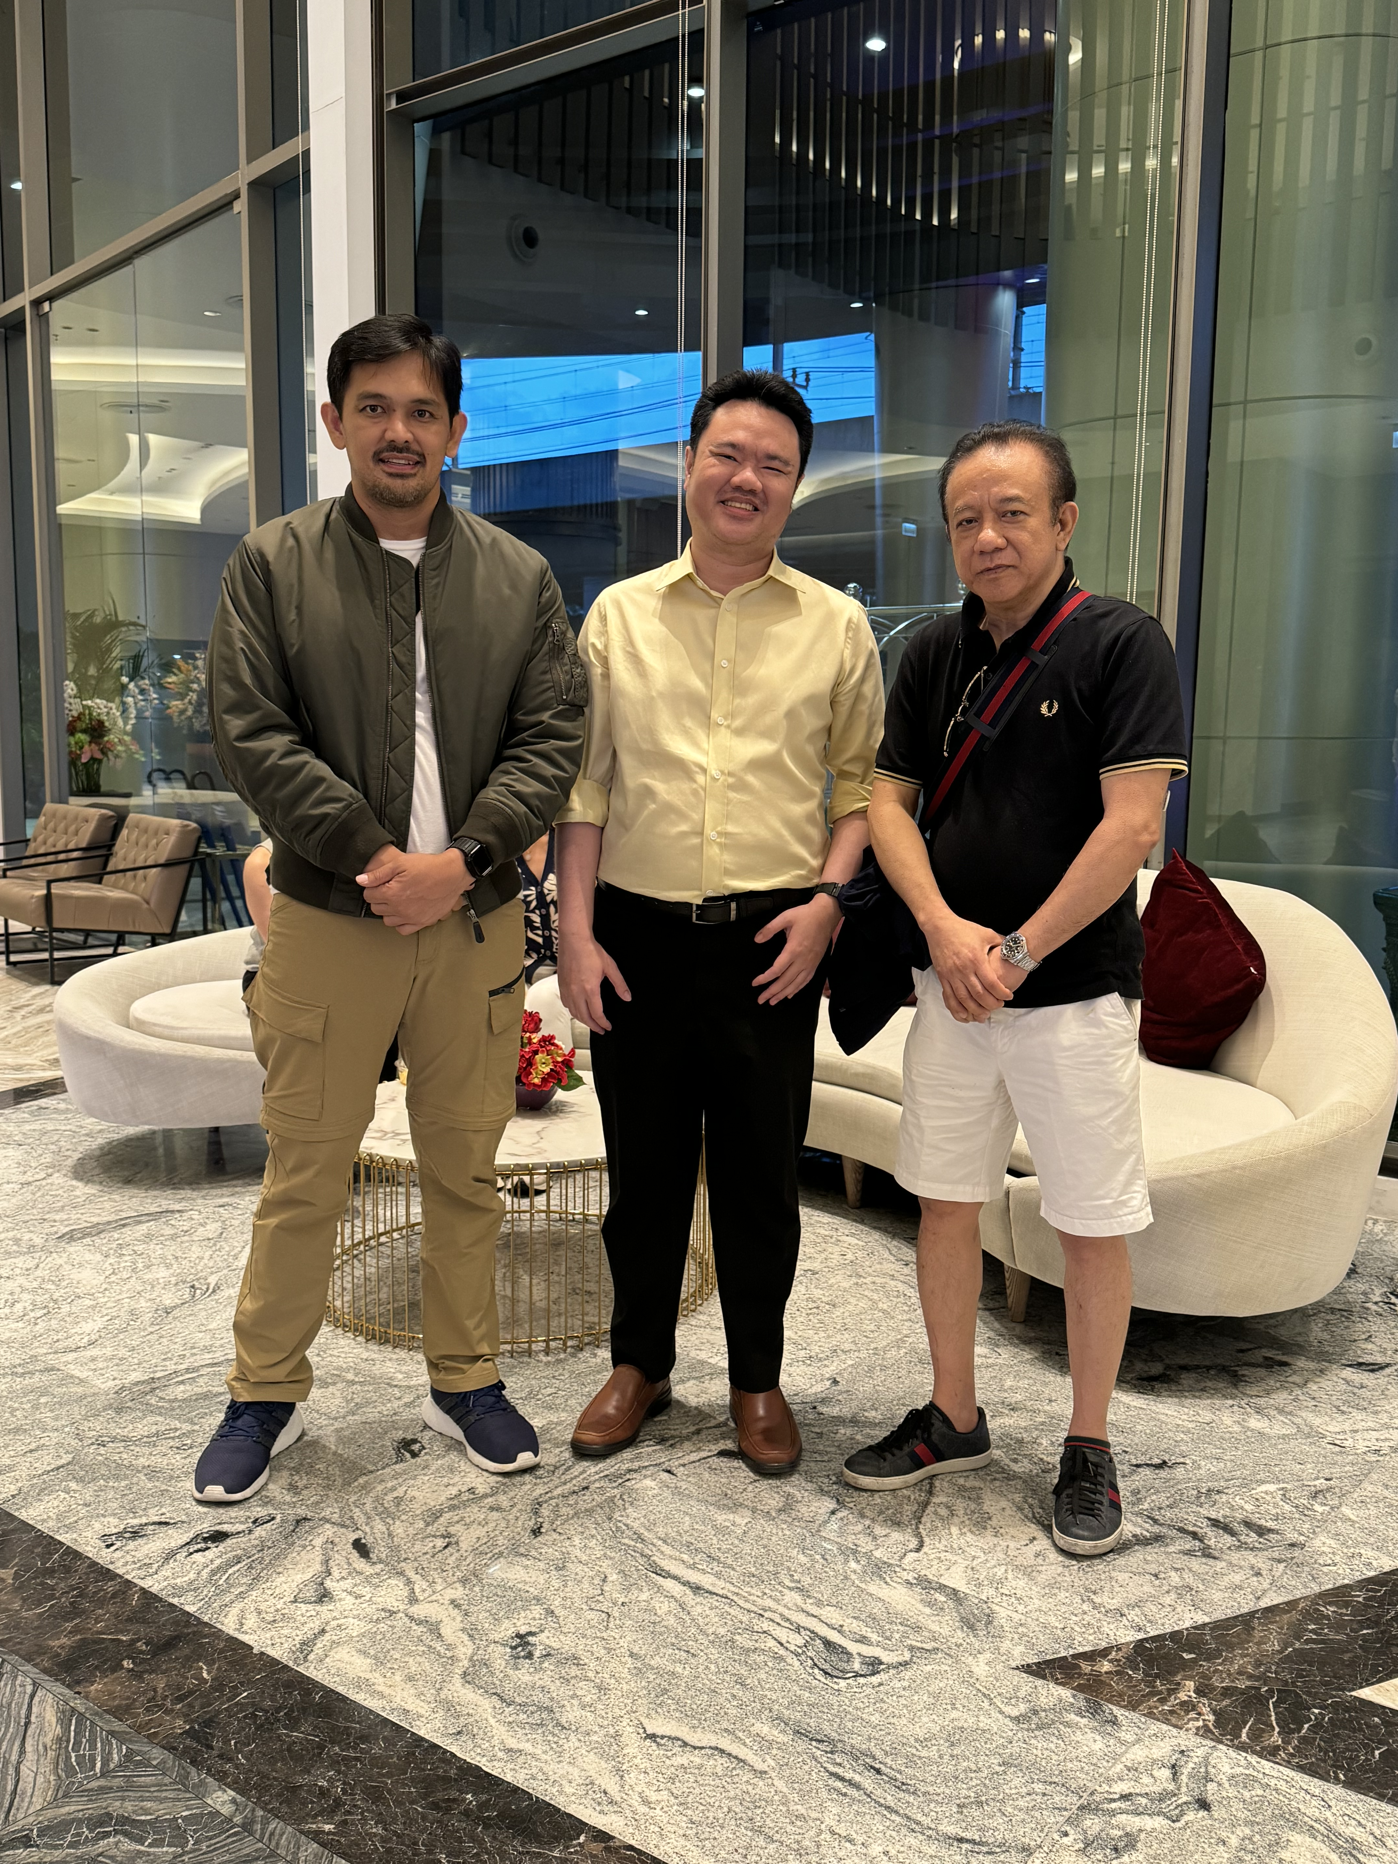
This cooperation extended worldwide
This is Kamon from
National Anti-Corruption Commission
of Thailand (NACCT)
He attended a 2 week
Seminar on anti corruption together with
representatives from other countries
worldwide... The cooperation turned into
a lasting friendship…
This is what WACC is doing now!
=

Slide 9
THE SEMINAR
In the seminar, we learned that with the use of technology, it only takes 95 dedicated people in China to monitor complaints and refer them to the appropriate agencies for immediate action.

Slide 10
CONCLUSION
WE NEED TO ACCEPT THE FACT THAT ALTHOUGH WE HAVE DIFFERENT FORMS OF GOVERNMENT, LAWS, AND CULTURE WE NEED TO FIND A COMMON GROUND THAT WILL BIND US TOGETHER, SUCH AS THE USE OF TECHNOLOGY AND SHARING OF INFORMATION TO WIN THE FIGHT AGAINST CORRUPTION IN OUR REGION.
UNITY IN DIVERSITY THROUGH TECHNOLOGY!

Slide 11
N
SA

