Slide 1
Strengthening Good Governance in the Next Normal: The Role of SAIs in Regional Anti-Corruption
Dr.Sutthi Suntharanurak
State Audit Office of the Kingdom of Thailand

Slide 2
Global Challenges by Twin Disruption
The twin disruptions of digital transformation and the COVID-19 pandemic have created a range of global challenges for governments, businesses, and society.

Slide 3
Global challenges in the next normal
Economic recovery
Health security
Digital transformation
Climate change
Social inequality
Demographic shifts

Slide 4
Key findings from the first short research paper: Preparing SAI for the future of good governance
Future of good governance
Leveraging technology and digital transformation
Prioritizing sustainability for good governance
Addressing social equity and inclusion

Slide 5
Leveraging technology and digital transformation
Good governance must leverage technology to improve service delivery, increase transparency and accountability, and engage with citizens in new and innovative ways.
This includes promoting digital inclusion and addressing the digital divide.

Slide 6
Prioritizing sustainability for good governance
Good governance must prioritize sustainability, including through policies promoting renewable energy, energy efficiency, and environmental protection.

Slide 7
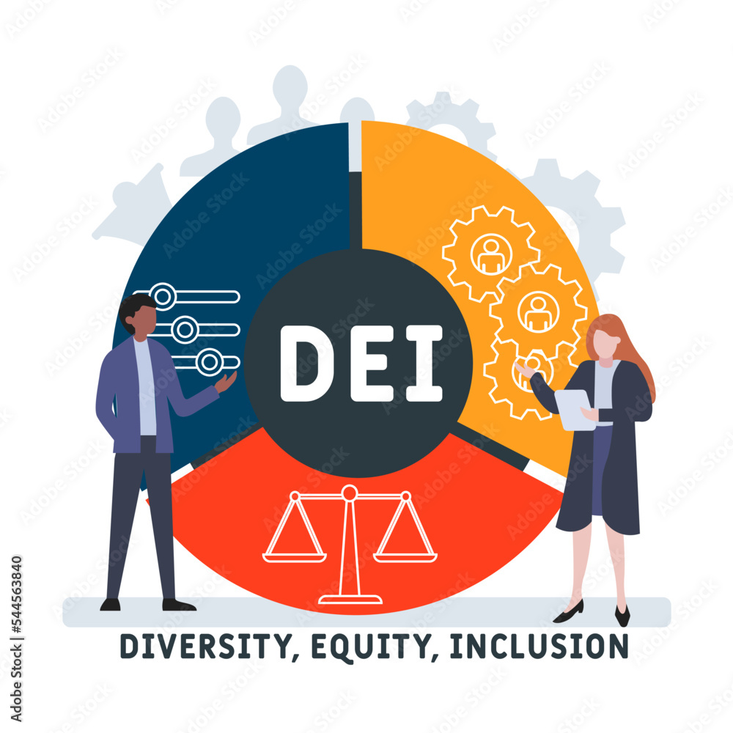
Addressing social equity and inclusion
Good governance must address this to promote a more just and equitable society.
This includes policies that promote education, job training, healthcare access, entrepreneurship, and efforts to reduce discrimination and increase representation for marginalized communities.

Slide 8
AIR model for the future of good governance
The future of good governance must be adaptive, innovative, and responsive to emerging challenges and prioritize transparency, accountability, and citizen engagement.
We call the AIR model.
Adaptive
Innovative
Responsive

Slide 9
Implementing the AIR model for SAI supporting the future of good governance
Building Strategic Agility
Promoting Digital Transformation
Fostering Collaboration and Partnerships
Promoting Innovation
Strengthening Capacity

Slide 10
Building Strategic Agility
SAIs need to adapt to a rapidly changing environment, and building strategic agility can help them do so.
SAIs should develop a clear vision, set strategic priorities, and engage stakeholders to understand emerging challenges and opportunities.

Slide 11
Promoting Digital Transformation
SAIs need to adapt by promoting digital transformation.
SAIs should include leveraging new technologies to improve service delivery, increase transparency and accountability, and engage with citizens in new and innovative ways.

Slide 12
Fostering Collaboration and Partnerships
SAIs cannot operate in isolation, and building partnerships and collaborations can help them leverage resources and expertise to achieve their goals.
SAIs should consider partnering with other SAIs, CSOs, ACAs, and other stakeholders to promote good governance and achieve shared objectives.

Slide 13
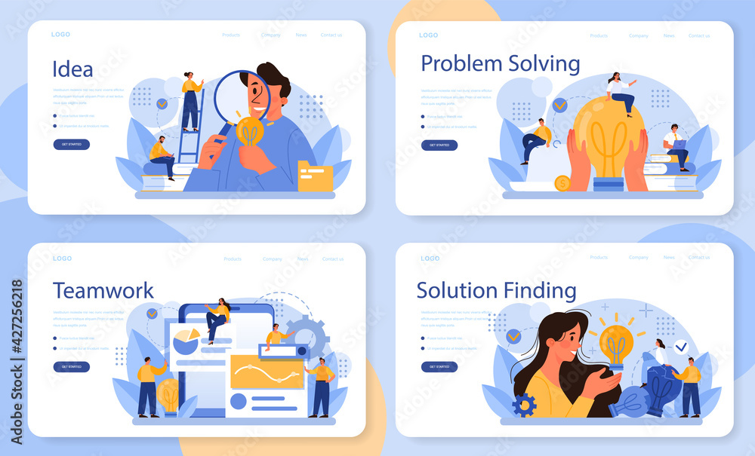
Promoting Innovation
To stay ahead of emerging challenges, SAIs need to promote innovation and creativity.
SAIs may involve adopting new methods and technologies, encouraging experimentation and risk-taking, and supporting a culture of innovation and continuous learning.

Slide 14
Strengthening Capacity
SAIs must strengthen their capacity by investing in their staff and resources.
SAIs should include developing training programs, fostering knowledge sharing and collaboration, and upgrading infrastructure and technology to support their work.

Slide 15
In summary
Preparing SAIs for the future of good governance requires a holistic approach that addresses emerging challenges and opportunities, builds strategic agility and resilience, and promotes collaboration, innovation, and capacity building.
By adopting these concrete approaches and methods, SAIs can position themselves as effective and impactful leaders in promoting good governance in the next normal.

Slide 16
Thank you for your attention
State Audit Office of the Kingdom of Thailand
Further Discussion
Please contact:
Dr. Sutthi Suntharanurak
State Audit Advisor
State Audit Office of the Kingdom of Thailand
sutthisun@gmail.com

