Slide 1
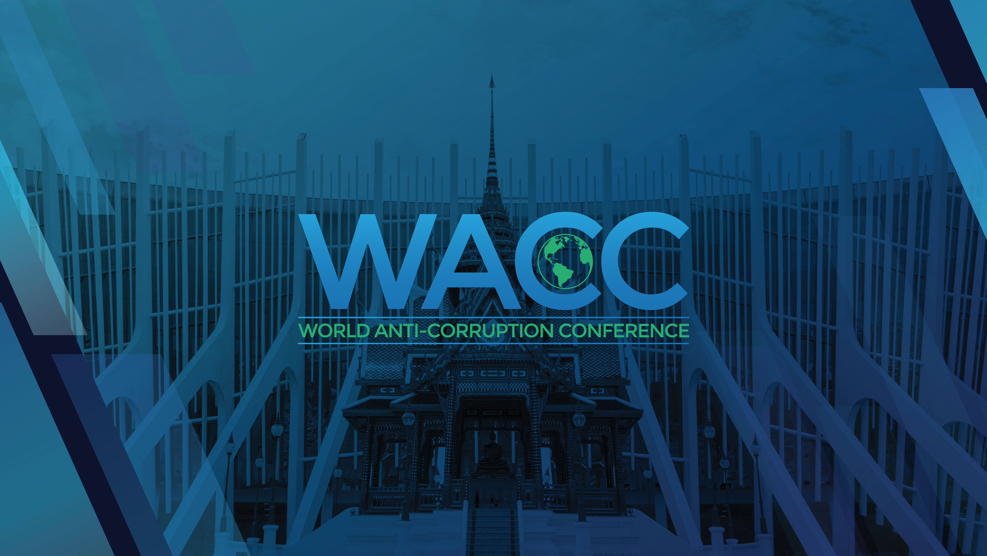

Slide 2
The Challenges of SMEs to Combat Against Corruption : Thailand Perspective.
Dr. Nidawan Pawcsuntorn
Faculty of Law,
Rangsit University.

Slide 3
The Challenges of SMEs to Combat Against Corruption: Thailand Perspective.
SMEs in Thailand and Barriers
Impacts of Corruption on SMEs
Substantial Laws and regulations
Thailand Corruption Index
Challenges of SMEs in Thailand
The solutions to combat corruption for SMEs in Thailand

Slide 4
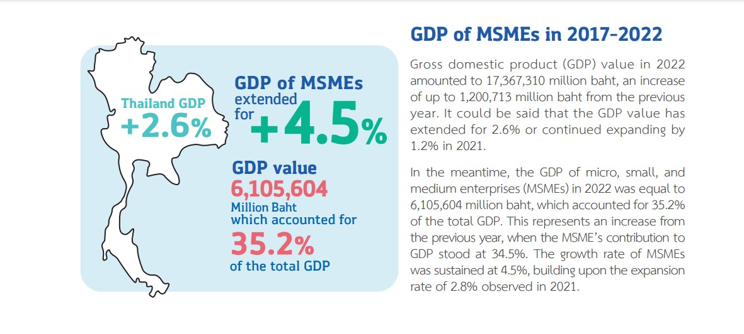
SMEs in Thailand

Slide 5
SMEs Barriers
Access to Finance
2. Regulatory Challenges
3. Competition Limited Market Access
4. Human Resource Constraints
5. Technological Barriers
6. Supply Chain Issues
7. Economic Volatility
8. Lack of Business Knowledge
9. Networking Limitations

Slide 6
Impacts of Corruption on SMEs
Unfair Competitions
obstructing economic growth

Slide 7
Substantial Laws and regulations : To prevent corruption in Thailand
1.Anti-Corruption Act
2.Organic Act on Counter Corruption
3.Public Sector Ethics Act
4.Disclosure Laws
5.Whistleblower Protection Act
6.Public Procurement Act

Slide 8
PUBLIC PROCUREMENT AND SUPPLIES ADMINISTRATION ACT ,B.E.2560 (2017)
CHAPTER II: Participation by the Public and business operators in anti-corruption
- An integrity pact
- Public observation

Slide 9
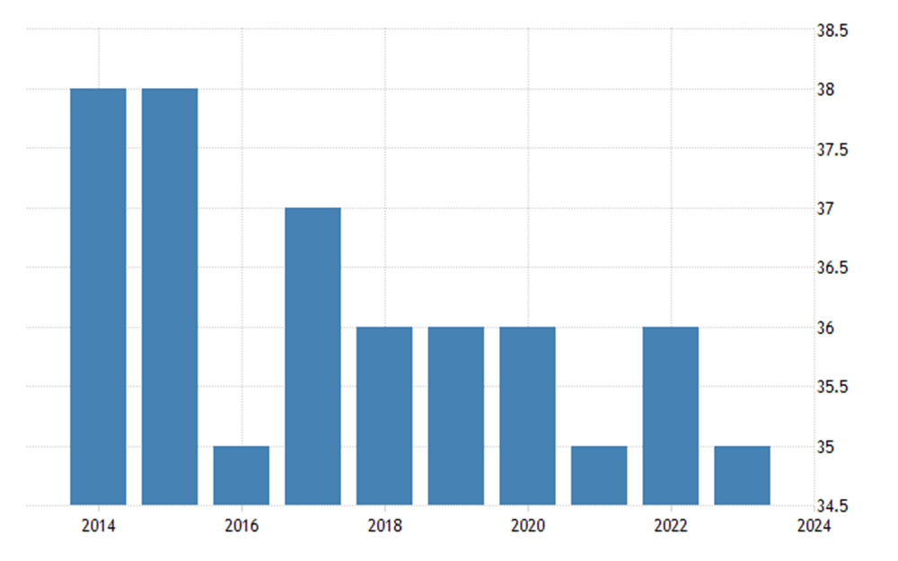
Thailand Corruption Index
Thailand scored 35 and ranked 108th out of 180 countries in the Corruption Perception Index in 2023.

Slide 10
Challenges of SMEs in Thailand
Environments with high corruption
and
Patronage system

Slide 11
The solutions to combat corruption for SMEs
Government:
1. Implements Thai SME promotion policies.
2. Promotes a culture of integrity and accountability.
3. Ensures transparency and effective law enforcement in governance.
SMEs:
1. Participate in collective actions and networks.
2. Maintain strong relationships with government officials and regulatory authorities to comply with laws and regulations.
Public:
1. Observes the processes of state agency procurement.
2. Advocates for more effective anti-corruption measures.

Slide 12
Thank You

